Slide 1
September 2026
Economic Overview www. GNODATACENTER.COM
CURRENT ASSESSMENT OF U.S., LOUISIANA, NEW ORLEANS MSA and CITY OF NEW ORLEANS
Prepared By
Dr. Raymond J. Brady
Systems SOLUTIONS
CONSULTING

Slide 2
September Update of the
U.S. 2026 Economic Outlook:
Key Words:
Economic and Policy Uncertainty
Policy Chaos
Consumer Spending: ????
Data: The Rear-View Mirror Problem

Slide 3

Annualized
Real GDP 2nd Quarter 2026 2nd Estimate) | 1,5%
Current-Dollar (annualized) | 7.9%
Real GDP 2nd Quarter 2025 (Final Estimate) | 3.0%
Current-Dollars (annualized) | 5.0%
Source: Bureau of Economic Analysis
PCE Price Index (Change from Month Previous Year)
July 2026 | 3.7%
June 2026 | 3.7%
May 2026 | 4.1%
July 2025 | 2.6%
June 2025 | 2.6%
Source: Bureau of Economic Analysis
Percentage Change Seasonally Adjusted Expenditures in Food and Drinking Places
August 2019-August 2018 | 3..8%
August 2025-August 2024 | 4.5%
August 2026-August 2025 | 6.0%
Source: Federal Reserve Bank of St. Louis (current adjusted $)
Personal Savings as a % of Disposable Income (Seasonally Adjusted at Annual Rates)
July 2026 | 3.0%
July 2024 | 4.5%
July 2019 | 6.8%
Source: Bureau of Economic Analysis
SUMMARY OF
U.S. DATA

Slide 4

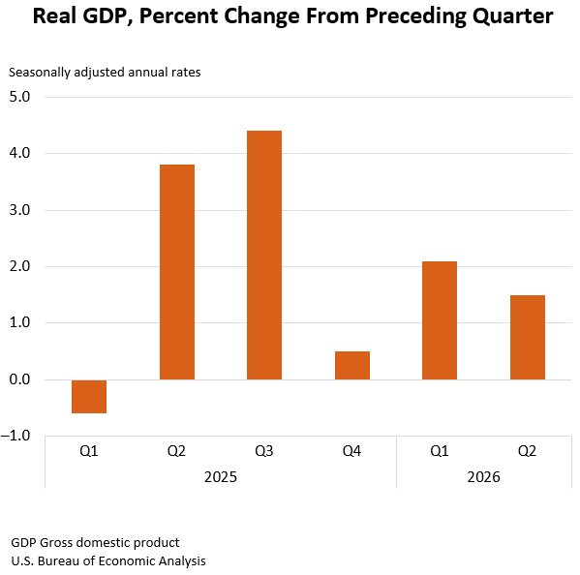
What does the 2nd quarter 2026 U.S. GDP
2nd Estimate Tell Us.
According to the U.S. Bureau of Economic Analysis (BEA)
Real Gross Domestic Product increased by an annualized rate of 1.5%
BEA states that “the contributors to the increase in real GDP in the second quarter were increases in consumer spending, exports, and investment that were partly offset by a decrease in government spending. Imports, which are a subtraction in the calculation of GDP, increased.
The price index for gross domestic purchases increased 5.8 percent in the second quarter, revised up 0.1 percentage point from the previous estimate. The personal consumption expenditures (PCE) price index increased 5.3 percent, revised up 0.2 percentage point, and the PCE price index excluding food and energy increased 3.6 percent, also revised up 0.2 percentage point.”

Slide 5
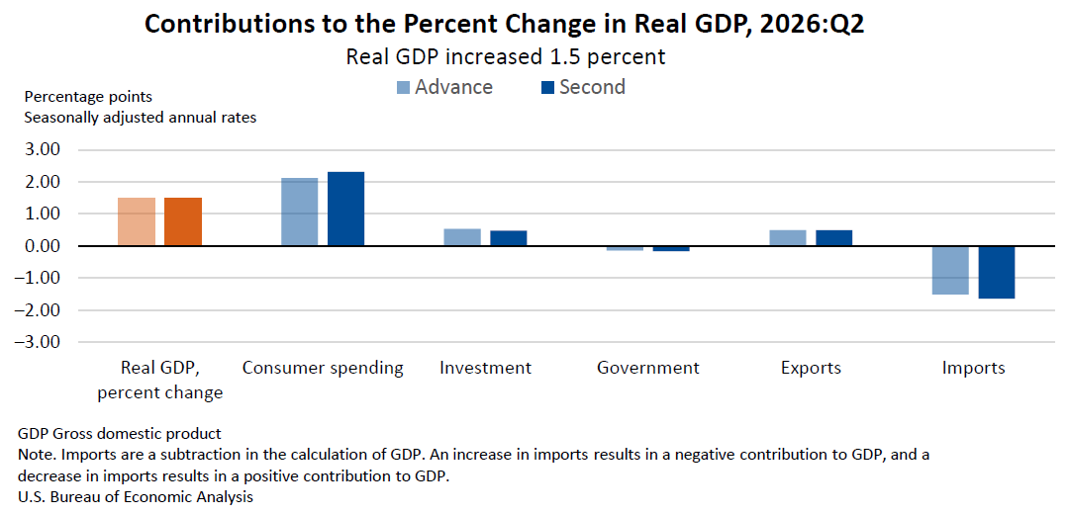
Components of Change in the 2nd quarter 2026

Slide 6

Latest Survey Report from Issued AT the Federal Reserve Bank of New York on Household Consumption Expectations
August 2026
August Survey: Inflation Expectations Tick Down at Medium-Term, Remain Unchanged at Short- and Longer-Term Horizons; Unemployment Expectations Deteriorate
Median inflation expectations decreased by 0.1 percentage point (ppt) to 3.2 percent at the three-year-ahead horizon and were unchanged at 3.6 percent and 3.0 percent, respectively, at the one-year and five-year-ahead horizons.
Gas price growth expectations increased again in August, rising by 1.7 ppt to 4.6 percent.
Mean unemployment expectations—or the mean probability that the U.S. unemployment rate will be higher one year from now—increased by 1.6 ppt to 44.4 percent, its highest reading since April 2020. The mean perceived probability of finding a job if one’s current job was lost decreased by 0.8 ppt to 45.4 percent.
The mean perceived probability of losing one’s job in the next twelve months decreased by 0.4 ppt to 13.8 percent, its lowest reading since February 2026. The mean probability of leaving one’s job voluntarily, or the expected quit rate, in the next twelve months increased by 0.9 ppt to 19.5 percent, above the series’ 12-month trailing average of 18.4 percent.

Slide 7
Inflation Indices

Slide 8
CURRENT CONSUMER PRICE CHANGE
3.4% Increase in the index from
August 2025 to August 2026

Slide 9
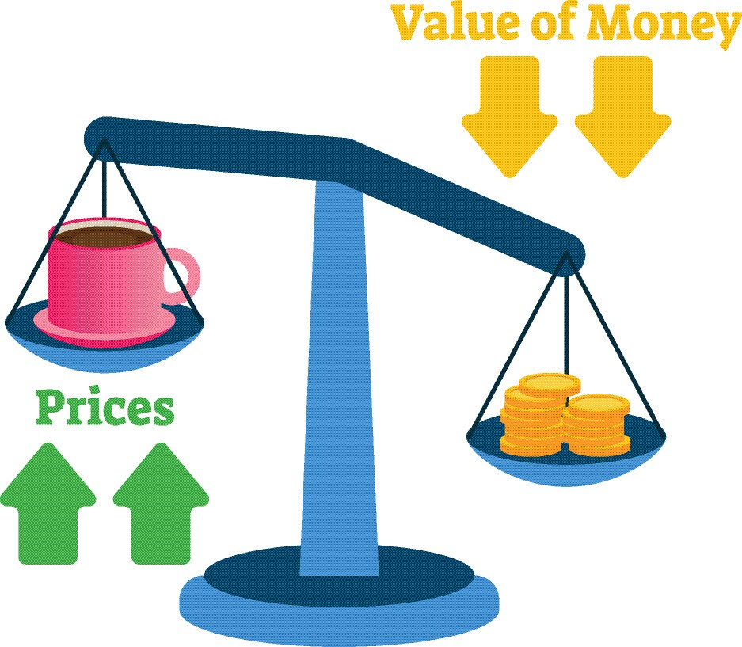

Slide 10

CPI Price Inflation:
(Non-Seasonally Adjusted Data)
Outside of Food at Home and Energy Prices Remain Sticky
August 2026 over August 2025
  All Items: 3.4% Increase
  Food at Home: 2.2% Increase
  Food Away from Home: 3.4% Increase
  Energy Commodities: 28%
  Energy Services: 4.0% Increase
  Shelter: 3.0% Increase
  Medical Services: 2.5% Increase
  All Items Less Food and Energy: 2.4% Increase
Twelve Month Change (private industry)
Total Civilian Workers Compensation Non-Seasonally June 2025 to June 2026: Civilian Workers, 3.3%
Source: Bureau of Labor Statistics

Slide 11
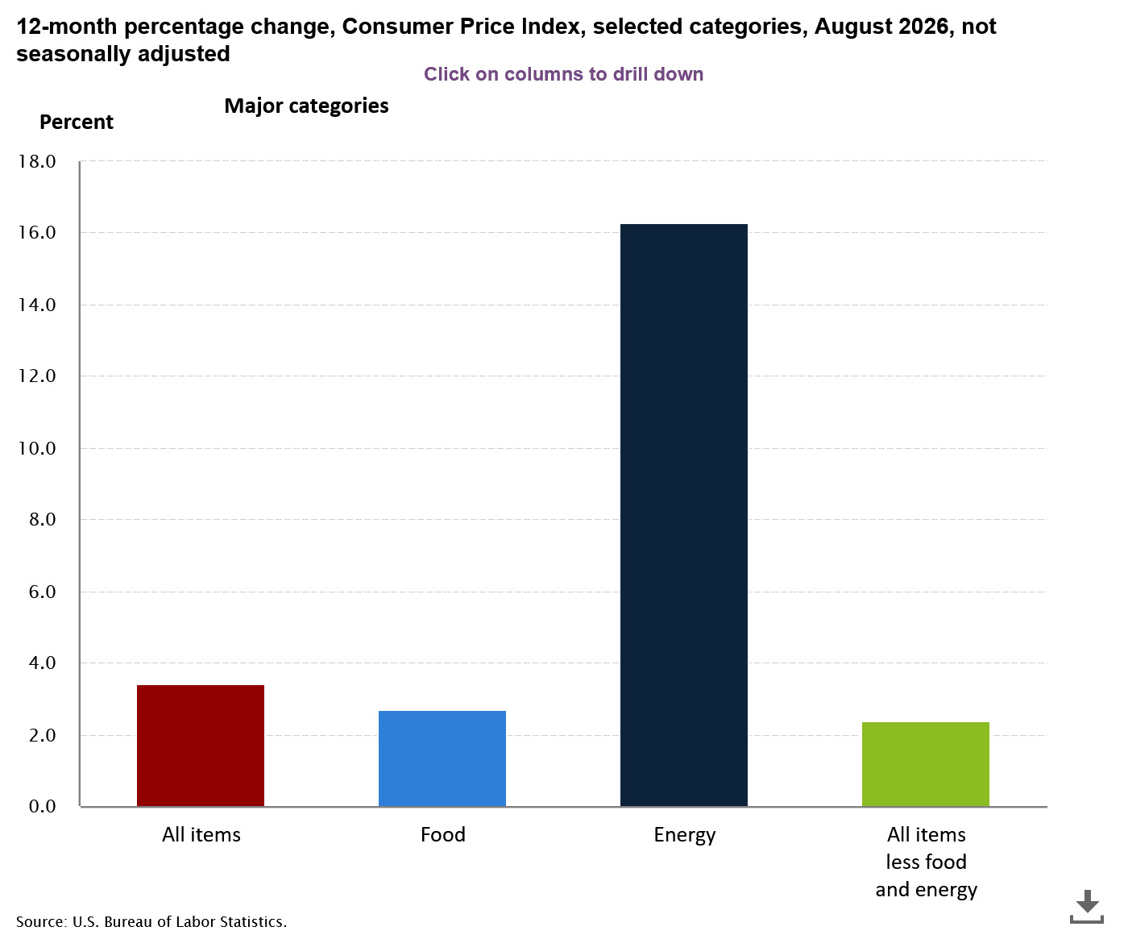
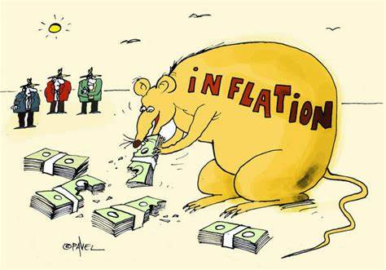

Slide 12
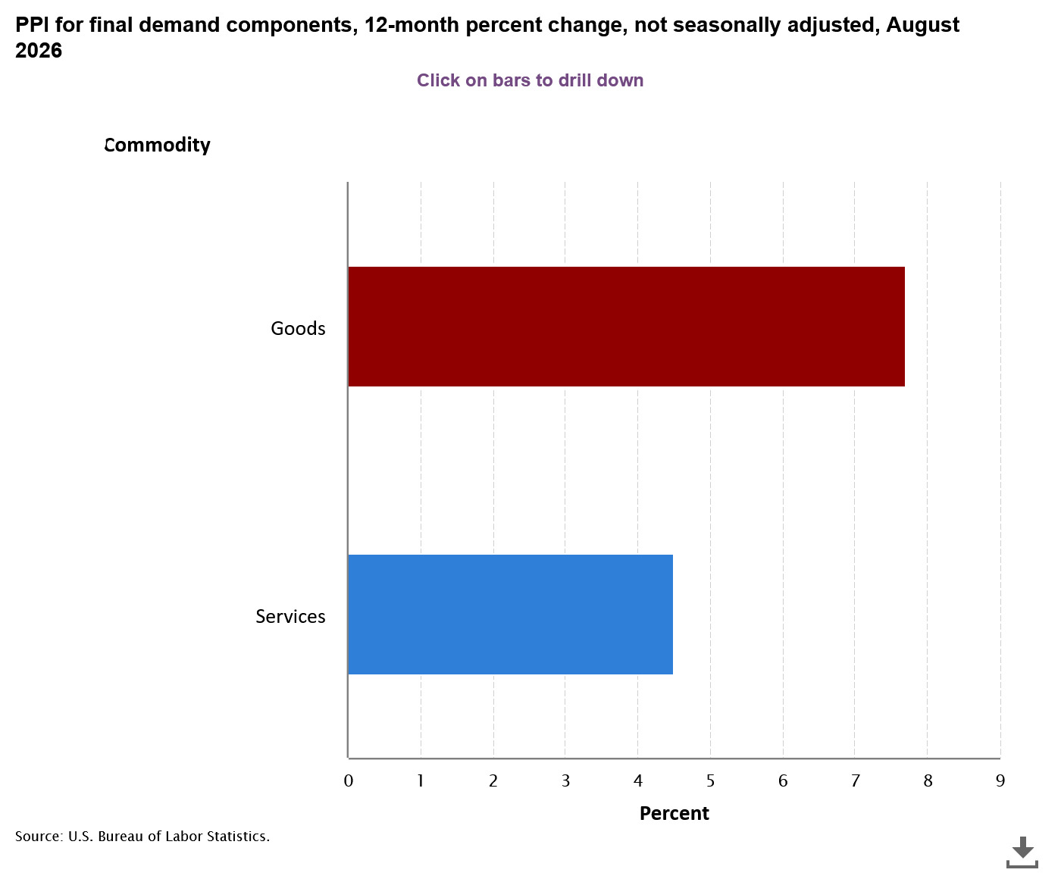
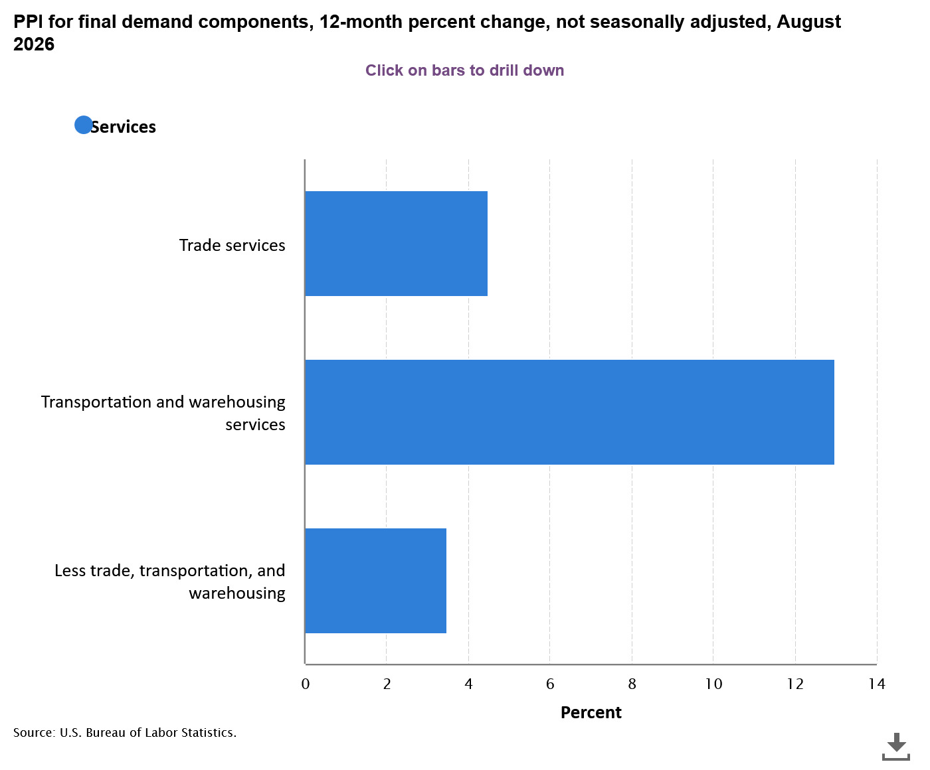
Producer Price Inflation Index:
Inflation Concentrated in Services

Slide 13
PPI Index: Peaked in March 2022
Services minus trade, transportation and warehousing was moving on a declining or stable trend up to end of 2025
August 2024 = 3.5%
August 2025 = 3.0%
August 2026 = 4.7%
Recent BLS “Hires and Openings” data suggest employers continue cutting back on hires.
Producer Price Index Data up to August 2026
Wage, Salary and Benefits Data Up to June 2026
June 2026: wages =3.2% : Benefits = 3.8%

Slide 14

Wage Pressure Affecting General Price Inflation
Product Supply Conditions
Labor Force Growth

Slide 15
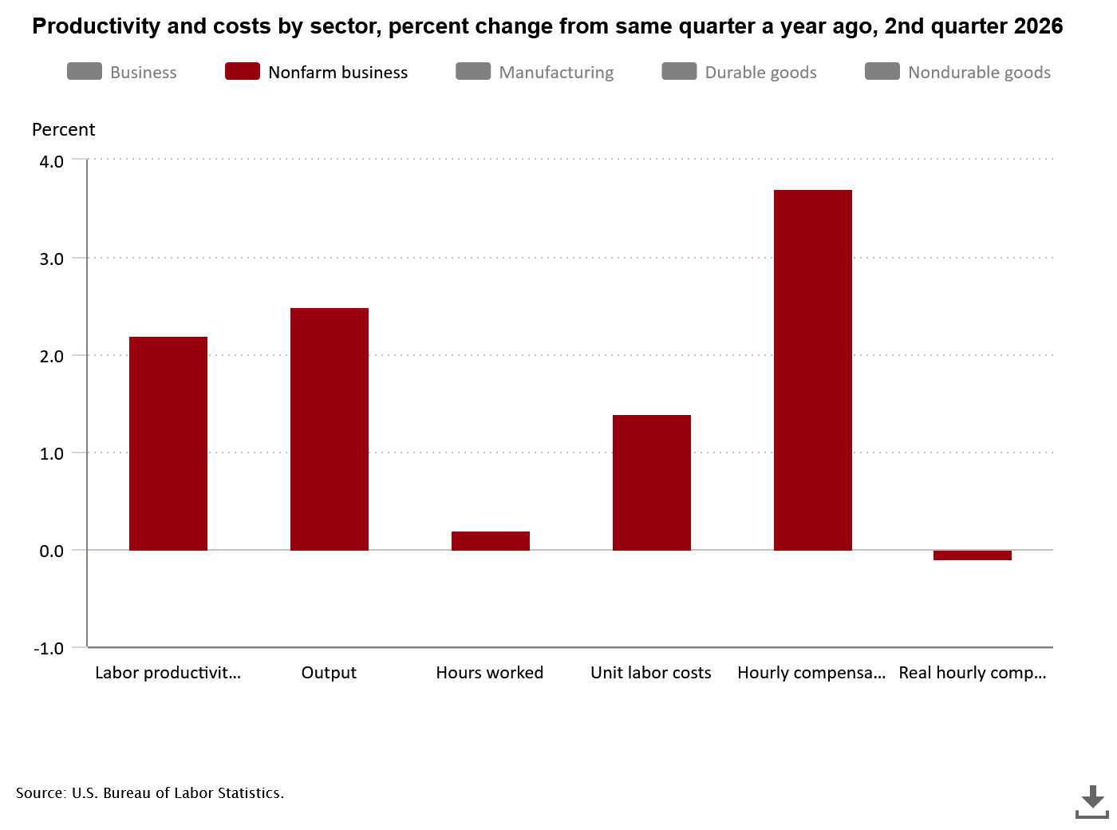
Productivity Weak
Statistics reflect change from same quarter a year ago at annualized rate
3.7%
Nonfarm business sector labor productivity increased 2.2% percent in the 2nd quarter 2026 over the 2nd quarter 2025
Unit labor costs in the nonfarm sector increased by 1.4 % in the 2nd quarter 2026 over previous year quarter.
Real average hourly earnings fell by 0.1% over the same quarter in 2026.
Source: Bureau of Labor Statistics
2.2%
2.5%
1.4%
0.2%
-0.1%

Slide 16
Mixed Messages: Major Manufacturing and Service Industries Indices Pointing to a “potential” Stall in Growth

Slide 17
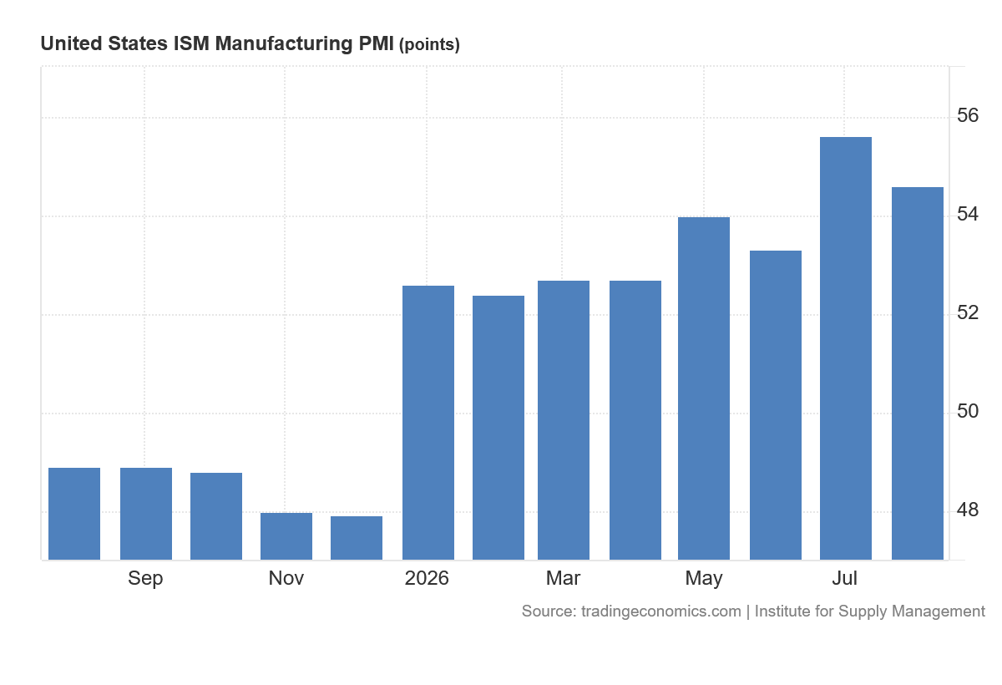
Manufacturing Purchasing Managers New Orders Index
Manufacturers Purchasing Managers New Orders Index (PMI) in August 2026 was 54.6
Source: tradingeconommics.com
A PMI reading above 50 percent indicates that the manufacturing economy is generally expanding; below 50 percent indicates that it is generally declining.

Slide 18
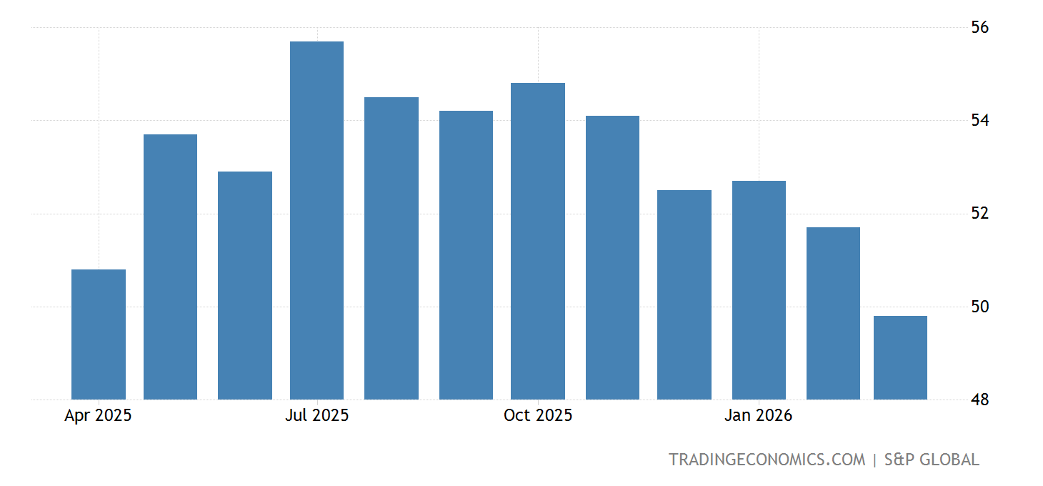
Weakening Growth
To quote the “Trading Economics” Report:
“ The S&P Global US Services PMI fell to 49.8 in March 2026.”
“The S&P Global US Services PMI fell to 49.8 in March of 2026 from 51.7 in the previous month, revised lower from the preliminary estimate of 51.1, signaling the first contraction in the sector in over three years. The decline came amid the weakest growth in new business since April 2024, as firms cited reduced client confidence and softer demand, partly linked to the impact of the Middle East conflict. Export activity also deteriorated further, with tariffs and geopolitical tensions weighing on trade. Business sentiment weakened to a five-month low as rising energy costs raised concerns over inflation and consumer spending. Employment edged lower for the first time since December, reflecting caution among firms. Input cost inflation accelerated to its highest level this year, driven largely by higher energy prices.”
: S&P Global
Services Purchasing Managers Index (PMI)
Source: Trading Economics

Slide 19
Independent Data Still Finds Bottlenecks in Finding Skilled Labor

Slide 20
Hires in July 2026, in absolute terms, Were the lowest since July 2015
Layoffs and discharges have stabilize
As of July 2026, there were 0.99 job openings for every unemployed (non-seasonally adjusted data)
Potential Consequences: rapid slowdown in hiring
Excess aggregate Labor downward pressure on wage increase

Slide 21
The Job and Labor Force Situation

Slide 22
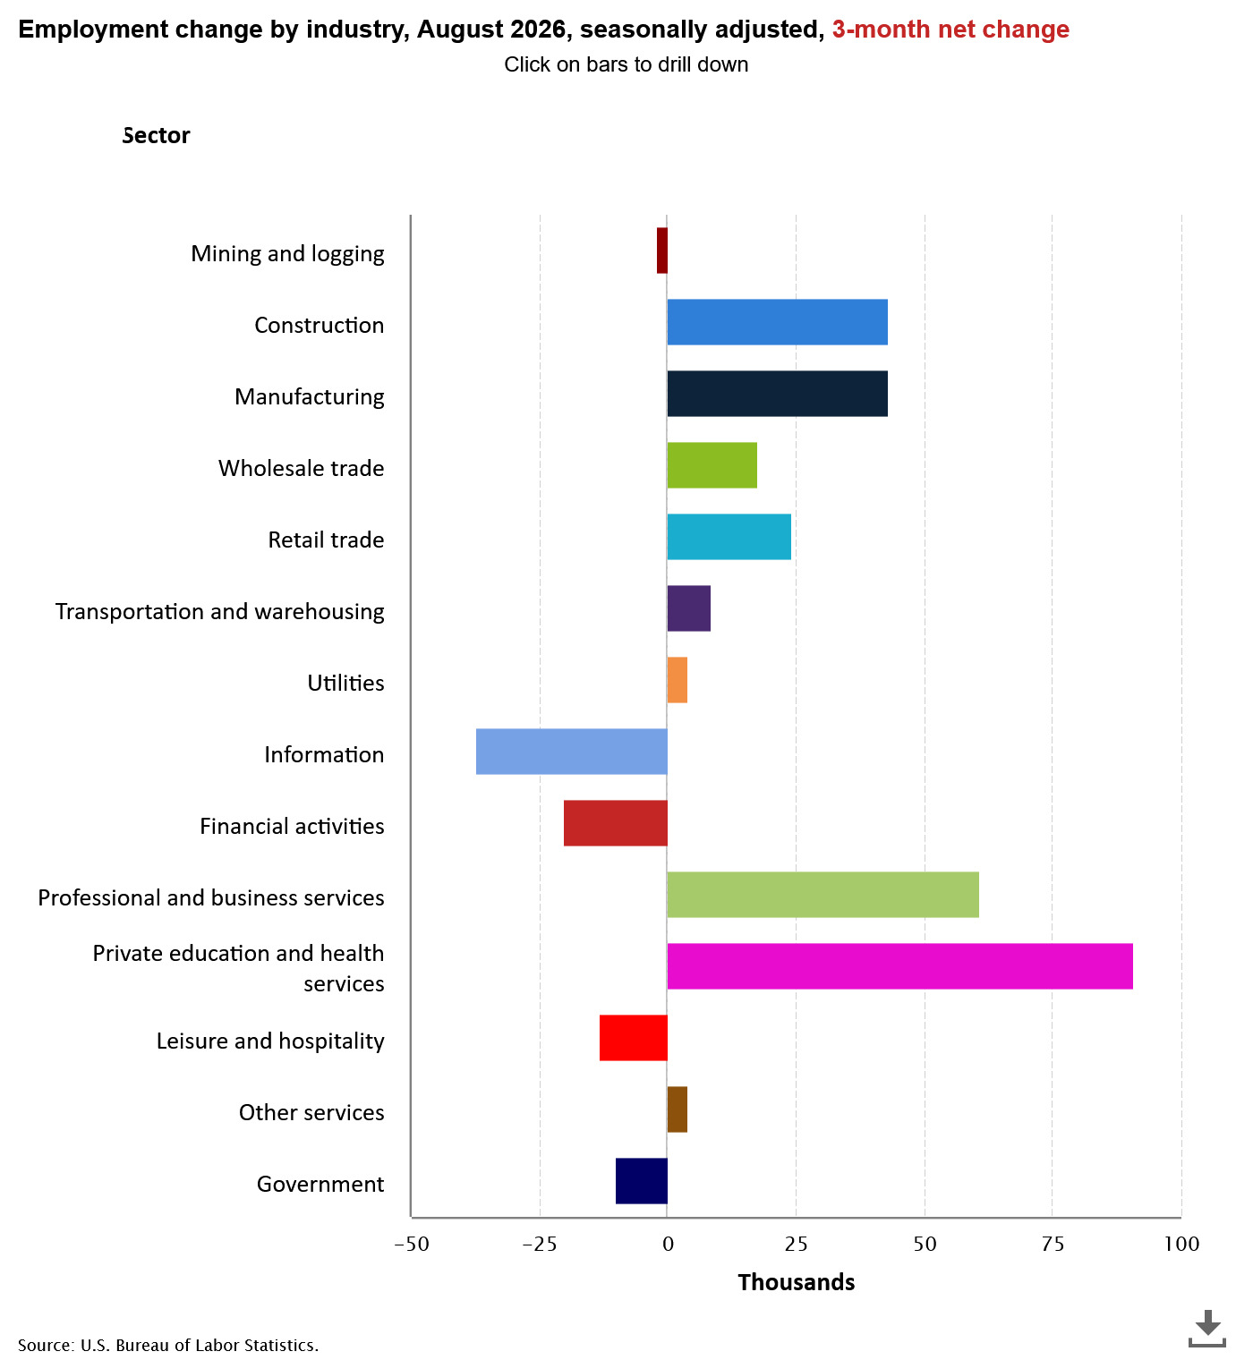
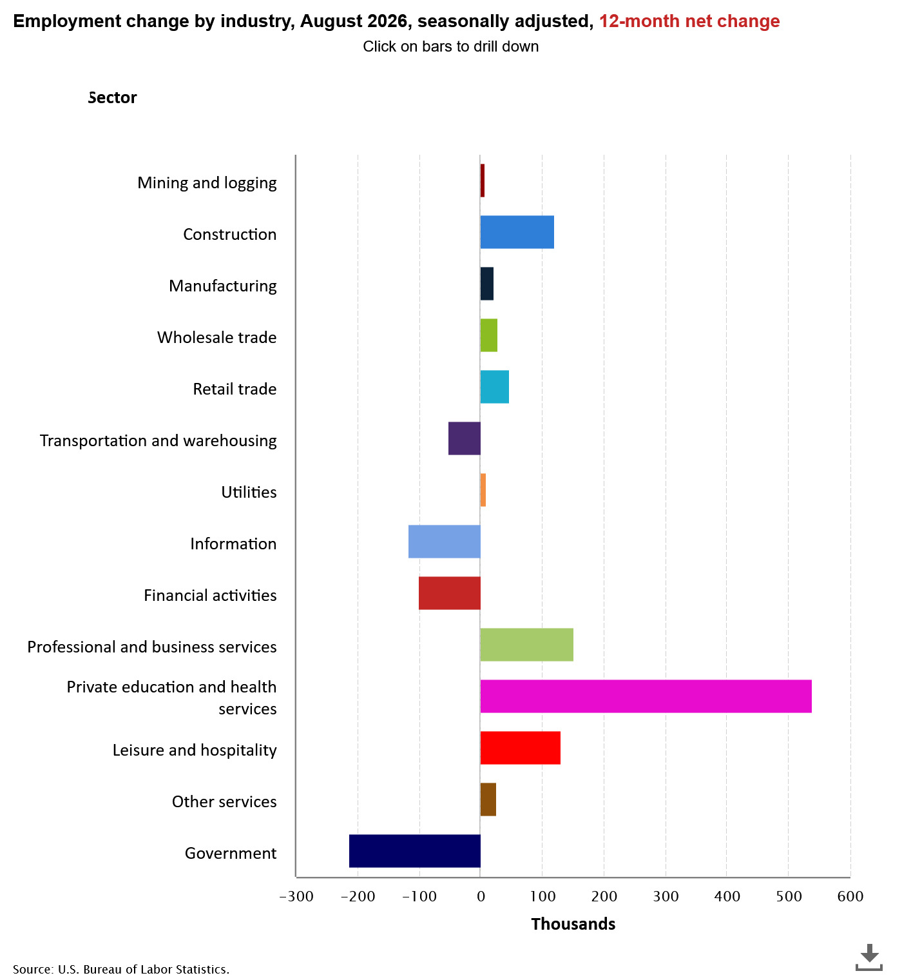
U.S. Employment Change Viewed
From A three-month and a twelve-month Change

Slide 23
Year 2008 indicates Participation Rate Pattern Change
Primary Causes…
Population aging, and Decline in the number of people who want to work
(source: National Bureau of Economic Research, “Declining Desire to work and Downward Trends in Unemployment and Participation,” Working Paper 21252, June 2015)

Slide 24
The Problem:
Stagnation (see above chart) in Labor force Growth (possibly) limiting Potential Job Growth?
Adjusted for Price Inflation, long term Real Potential Personal Income Growth LESS than trend
116574.3
438.8672

Slide 25
A Closer Look At Accommodations and Food Services In Leisure and Hospitality
Total U.S. (seasonally adjusted) Employment in Accommodations and Food Services was still 39 thousand fewer in August 2026 than the previous employment high point of February 2020 (14,393 million jobs). (Source: BLS)
1
If measured on an annual average basis (2026 reflects nine months of data), U.S. Accommodations and Food Services was 145 thousand greater in 2026 than in 2019. (Source: BLS) seasonally adjusted 2019 is used because year 2000 data was totally distorted by the COVID 19
2
In Accommodations and Foods Service in July 2026:
Opening = 897 thousand jobs.
Hires =817 thousand
Layoffs = 244 thousand.
(all data are non-seasonally adjusted) Note: number of hires is lowest since 2014.
3

Slide 26
The National Unemployment Situation
Percent unemployed
Source: BLS Current Population Survey
Seasonally Adjusted
Month | Total | White | Black or African American | Asian | Hispanic or Latino
Dec 2021 | 3.9 | 3.3 | 7.0 | 3.8 | 4.8
Dec 2022 | 3.5 | 3.0 | 5.7 | 2.4 | 4.1
Jan 2023 | 3.4 | 3.1 | 5.4 | 2.8 | 4.5
Jan. 2024 | 3.7 | 3.4 | 5.3 | 2.9 | 5.0
July | 4.2 | 3.8 | 6.2 | 3.6 | 5.3
December | 4.1 | 3.6 | 6.1 | 3.5 | 5.1
Jan. 2025 | 4.0 | 3.5 | 6.2 | 3.7 | 4.8
July | 4.3 | 3.7 | 7.2 | 3.9 | 5.0
Dec. 2025 | 4.4 | 3.8 | 6.9 | 3.6 | 4.8
September 2026 | 4.1 | 3.7 | 6.0 | 3.2 | 4.8

Slide 27
A SNAPSHOT OF
CONSUMER BEHAVIOR
Source: BEA and Census Bureau

Slide 28
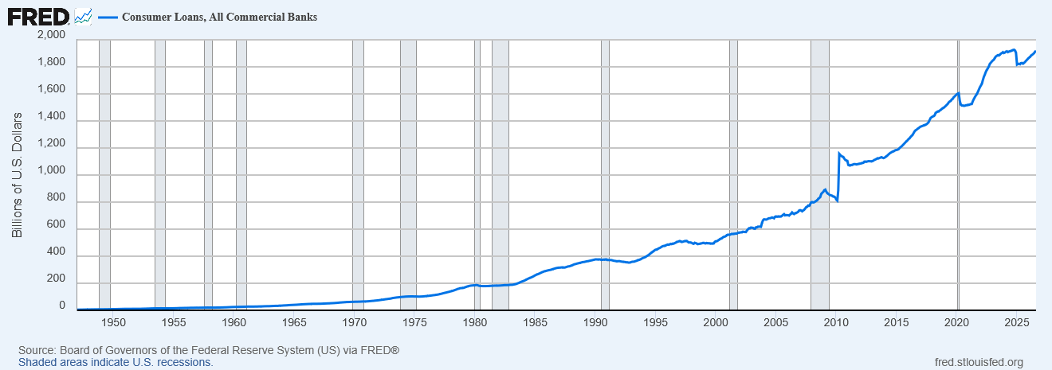
Consumer Credit Level: 1.1 Trillion $
August 2025
Loans, Credit Card and other Revolving Plans.
Savings Rate as a Percentage of Disposable Income Falling. (recall savings rate in “Summary of U.S.” Chart)
Consumer Loans, All Commercial Banks
1.9 Trillion $
August 2026

Slide 29
Thoughts on the National Outlook
Inflation, Lots of Uncertainty…
Budget Priorities, Erratic Public Policies, Distortions in the Marketplace
Background--International Instability

Slide 30
Current Louisiana Economic Outlook:
Key Words:
  Uncertainty Less So
  Job Growth Not Widespread Relative to U.S.
  Personal Income Growth Driven by
  Dividends, Interest, Rent, Transfer Payments and Health Care
  Major Long-Term Problems with Inflation Adjusted Labor Productivity, Output and Value-Added Per Worker Growth in Louisiana: Structural Changes in the Louisiana(?)

Slide 31
Louisiana’s 2026 2nd Quarter Data
Sales and Income Tax Collections Stagnating

Slide 32
Snapshot of Primary Sources of Louisiana State Revenues
Note: Sales Tax Collections Reflect Broader Base of Collections and Higher Tax Rate
Values are in Current $

Slide 33
Data Shows: Louisiana Job Economy
Lagging U.S. Job Growth
Note: Dips in Data reflects Non-Seasonal Adjustment
Trend most important

Slide 34
The Reality: total number of CES non-farm jobs in August 2026 were 3.4 % above the August 2005 (pre-Katrina) CES Job Level
August 2026 index reading = 103.4
August 2005 = 100

Slide 35
Source: Current Employment Survey, Bureau of Labor
STATE OF LOUISIANA |  | Total Non-Farm Employment August 2026
Non-Seasonally Adjusted Job Growth August 2025 to August 2026
Construction | 17,100 | 152,600
Professional and Business Services | 6,400 | 226,900
Health Care and Social Assistance | 4,900 | 306,700
Manufacturing | 3,300 | 143,700
Private Educational Services | 2,100 | 52,800
Government | 100 | 317,600
Wholesale Trade | 100 | 68,500
All Others | 100 | 134,200
Truck Transportation | -100 | 16,800
Leisure and Hospitality | -500 | 225,500
Support Activities in Transportation | -600 | 19,400
Retail Trade | -700 | 211,100
Mining | -900 | 27,500
Information | -900 | 16,500
Financial Activities | -1,600 | 92,000
Total Change | 28,800 | 2,011,800
Note: 98.6% of the CES job growth during this period was
in four sectors.

Slide 36
Louisiana Leisure and Hospitality Industry: little change in hours worked, Increase in Average Pay

Slide 37
Louisiana’s Personal Income Growth in 2026 Driven by Personal Transfer Payments

Slide 38
Personal Transfer Payments as A Percentage of Total Personal Income:
Louisiana’s Personal Income Level Highly Dependent of Transfer Payments
1st Quarter 2026
Transfer Payments consist of:
  Social Security Benefits
  Medicare Benefits
  Medicare Benefits
  All Other transfer Benefits
Transfer Benefits as a percentage of total Personal Income
Louisiana = 24.9%
Alabama = 24.9%
South Carolina = 24.0%
California = 17.5%
  Louisiana Transfer Benefits for Medicaid highest among selected states
    Louisiana = 5.9% of Total PI
    Alabama = 2.6% of Total PI
    South Carolina = 2.9% of Total PI
    California = 5.3% of Total PI

Slide 39
Louisiana’s Personal
Income Growth
Source: Bureau of Economic Analysis
Thousands of Current $
Personal Income Change For Select Components
4th Quarter 2019 to 1st Quarter 2026
Personal income (thousands of dollars, seasonally adjusted) | $80,844
Earnings by place of work | $42,522
Plus: Personal current transfer receipts | $26,237
Wages and salaries | $29,647
Proprietors' income | $6,992
Farm earnings | $233
Nonfarm earnings | $41,963
Private nonfarm earnings | $36,783
Health care and social assistance | $7,030
Professional, scientific, and technical services | $3,754
Manufacturing | $3,481
Construction | $3,404
Accommodation and food services | $1,552
Arts, entertainment, and recreation | $442
Mining, quarrying, and oil and gas extraction | $4

Slide 40
Louisiana
Description | 2019: Q1 | 2020:Q1 | 2023: Q1 | 2025:Q1 | 2026:Q1
Personal income (thousands of dollars, seasonally adjusted) Current $ | $218,081,048 | $221,684,120 | $275,886,604 | $291,634,086 | $301,753,064
Personal current transfer receipts (000) | $47,535,332 | $50,194,856 | $65,409,540 | $69,700,967 | $75,040,991
Social Security Benefits (000) | $13,954,460 | $14,543,116 | $18,248,152 | $20,497,838 | $21,255,138
Medicare benefits (000) | $11,703,880 | $12,259,136 | $16,070,836 | $17,820,440 | $19,763,626
Medicaid (000) | $11,411,976 | $12,071,120 | $16,711,972 | $14,739,926 | $17,693,304
State unemployment insurance compensation (000) | $176,072 | $593,264 | $170,952 | $143,520 | $134,234
All other personal current transfer receipts (000) | $10,288,944 | $10,728,220 | $14,207,628 | $16,499,243 | $16,194,689
Personal Current Transfers as a Fraction of Personal Income | 21.8% | 22.6% | 23.7% | 23.9% | 24.9%
Importance of Transfer Payments as a Fraction of PI
Personal Income Levels
Personal Transfer Payments
Other Transfer Payments
Note: Medicaid Growth
Source: Bureau of Economic Analysis

Slide 41
POPULATION ESTIMATES BY SOUTHERN STATE
SOURCE: U.S.CENSUS BUREAU

Slide 42
 | Population Data for Southern States
 | Alabama | Arkansas | Florida | Georgia | Kentucky | Louisiana | Mississippi | North Carolina | South Carolina | Tennessee | Texas | Virginia
2000 Census | 4,447,100 | 2,673,400 | 15,982,378 | 8,186,453 | 4,041,769 | 4,468,976 | 2,844,658 | 8,049,313 | 4,012,012 | 5,689,283 | 20,851,820 | 7,078,515
1-Jul-00 | 4,451,497 | 2,678,115 | 16,046,148 | 8,230,306 | 4,048,903 | 4,468,979 | 2,848,310 | 8,079,383 | 4,023,570 | 5,703,243 | 20,945,963 | 7,104,533
1-Jul-01 | 4,467,634 | 2,691,571 | 16,356,966 | 8,377,038 | 4,068,132 | 4,477,875 | 2,852,994 | 8,210,122 | 4,064,995 | 5,750,789 | 21,319,622 | 7,198,362
1-Jul-02 | 4,480,089 | 2,705,927 | 16,689,370 | 8,508,256 | 4,089,875 | 4,497,267 | 2,858,681 | 8,326,201 | 4,107,795 | 5,795,918 | 21,690,325 | 7,286,873
1-Jul-03 | 4,503,491 | 2,724,816 | 17,004,085 | 8,622,793 | 4,117,170 | 4,521,042 | 2,868,312 | 8,422,501 | 4,150,297 | 5,847,812 | 22,030,931 | 7,366,977
1-Jul-04 | 4,530,729 | 2,749,686 | 17,415,318 | 8,769,252 | 4,146,101 | 4,552,238 | 2,889,010 | 8,553,152 | 4,210,921 | 5,910,809 | 22,394,023 | 7,475,575
1-Jul-05 | 4,569,805 | 2,781,097 | 17,842,038 | 8,925,922 | 4,182,742 | 4,576,628 | 2,905,943 | 8,705,407 | 4,270,150 | 5,991,057 | 22,778,123 | 7,577,105
1-Jul-06 | 4,628,981 | 2,821,761 | 18,166,990 | 9,155,813 | 4,219,239 | 4,302,665 | 2,904,978 | 8,917,270 | 4,357,847 | 6,088,766 | 23,359,580 | 7,673,725
1-Jul-07 | 4,672,840 | 2,848,650 | 18,367,842 | 9,349,988 | 4,256,672 | 4,375,581 | 2,928,350 | 9,118,037 | 4,444,110 | 6,175,727 | 23,831,983 | 7,751,000
1-Jul-08 | 4,718,206 | 2,874,554 | 18,527,305 | 9,504,843 | 4,289,878 | 4,435,586 | 2,947,806 | 9,309,449 | 4,528,996 | 6,247,411 | 24,309,039 | 7,833,496
1-Jul-09 | 4,757,938 | 2,896,843 | 18,652,644 | 9,620,846 | 4,317,074 | 4,491,648 | 2,958,774 | 9,449,566 | 4,589,872 | 6,306,019 | 24,801,761 | 7,925,937
2010 Census | 4,779,736 | 2,915,918 | 18,801,310 | 9,687,653 | 4,339,367 | 4,533,372 | 2,967,297 | 9,535,483 | 4,625,364 | 6,346,105 | 25,145,561 | 8,001,024
1-Jul-10 | 4,785,514 | 2,921,998 | 18,846,143 | 9,712,209 | 4,348,464 | 4,544,635 | 2,970,615 | 9,574,586 | 4,635,846 | 6,355,518 | 25,241,897 | 8,024,004
1-Jul-11 | 4,788,095 | 2,921,546 | 18,842,405 | 9,712,616 | 4,349,159 | 4,544,804 | 2,970,367 | 9,571,037 | 4,633,669 | 6,400,298 | 25,645,504 | 8,102,437
1-Jul-12 | 4,812,576 | 2,938,773 | 19,036,879 | 9,805,666 | 4,374,302 | 4,577,089 | 2,977,902 | 9,641,131 | 4,661,744 | 6,356,388 | 25,238,386 | 8,025,105
1-Jul-13 | 4,839,947 | 2,948,793 | 19,268,256 | 9,907,250 | 4,394,147 | 4,603,590 | 2,982,356 | 9,719,755 | 4,699,358 | 6,404,657 | 25,627,909 | 8,107,953
1-Jul-14 | 4,865,253 | 2,954,563 | 19,502,928 | 9,980,892 | 4,415,978 | 4,628,239 | 2,986,599 | 9,800,429 | 4,738,067 | 6,463,610 | 26,052,403 | 8,197,400
1-Jul-15 | 4,887,757 | 2,961,050 | 19,790,139 | 10,078,133 | 4,428,854 | 4,648,813 | 2,987,656 | 9,876,774 | 4,789,723 | 6,508,290 | 26,433,846 | 8,270,221
1-Jul-16 | 4,909,177 | 2,970,210 | 20,140,379 | 10,191,912 | 4,443,778 | 4,670,550 | 2,985,000 | 9,962,464 | 4,850,136 | 6,559,452 | 26,903,208 | 8,334,206
1-Jul-17 | 4,931,579 | 2,980,475 | 20,533,473 | 10,318,636 | 4,457,755 | 4,685,576 | 2,984,364 | 10,072,775 | 4,908,404 | 6,613,679 | 27,394,564 | 8,390,494
1-Jul-18 | 4,953,096 | 2,990,702 | 20,868,335 | 10,428,854 | 4,475,829 | 4,678,580 | 2,983,448 | 10,172,498 | 4,963,742 | 6,673,101 | 27,825,975 | 8,445,270
1-Jul-19 | 4,977,088 | 2,997,195 | 21,131,181 | 10,532,841 | 4,487,302 | 4,670,033 | 2,974,657 | 10,273,864 | 5,019,607 | 6,740,060 | 28,188,852 | 8,503,046
1-Jul-20 | 4,921,532 | 3,030,522 | 21,733,312 | 10,710,017 | 4,477,251 | 4,645,318 | 2,966,786 | 10,600,823 | 5,218,040 | 6,806,981 | 28,508,309 | 8,547,370
2020 Census | 5,024,279 | 3,011,524 | 21,538,187 | 10,711,908 | 4,505,836 | 4,657,757 | 2,961,279 | 10,439,388 | 5,118,425 | 6,910,840 | 29,145,505 | 8,631,393
1-Jul-21 | 5,050,058 | 3,027,127 | 21,836,698 | 10,793,038 | 4,508,348 | 4,628,595 | 2,947,603 | 10,565,503 | 5,194,346 | 6,966,687 | 29,572,672 | 8,660,007
1-Jul-22 | 5,076,868 | 3,047,429 | 22,413,989 | 10,929,992 | 4,521,238 | 4,600,892 | 2,941,237 | 10,705,768 | 5,288,957 | 7,063,325 | 30,118,002 | 8,681,038
1-Jul-23 | 5,117,850 | 3,069,856 | 22,929,248 | 11,063,669 | 4,549,953 | 4,598,777 | 2,942,470 | 10,871,849 | 5,390,798 | 7,153,029 | 30,719,247 | 8,732,034
1-Jul-24 | 5,163,055 | 3,096,080 | 23,265,838 | 11,204,208 | 4,584,046 | 4,614,878 | 2,950,172 | 11,052,061 | 5,490,316 | 7,251,291 | 31,318,578 | 8,819,642
1-Jul-25 | 5,193,088 | 3,114,791 | 23,462,518 | 11,302,748 | 4,606,864 | 4,618,189 | 2,954,160 | 11,197,968 | 5,570,274 | 7,315,076 | 31,709,821 | 8,880,107
% Change 2000 to 2025 | 16.8% | 16.5% | 46.8% | 38.1% | 14.0% | 3.3% | 3.8% | 39.1% | 38.8% | 28.6% | 52.1% | 25.5%

Slide 43
The Most Worrisome Problem
Structural Changes in Louisiana’s Economy have Created Long Term
Competitive Problems with
Labor Productivity
Output Per Worker
Value-Added and Wealth Creation
Full report found on gnodatacenter.com working paper #3

Slide 44
Definitions
Labor productivity - measures the hourly output of an economy. Specifically, it charts the amount of real gross domestic product (GDP) produced by an hour of labor. Growth in labor productivity depends on three main factors: saving and investment in physical capital, new technology, and human capital.
Output Per Worker- A measure of productivity calculated by dividing the total output by the number of workers.
Real value-added output - removing the effect of price level changes from the nominal value of a good, service, or time-series data, to obtain a truer picture of economic trends.

Slide 45
Louisiana’s Economy Labor Productivity= 100

Slide 46
Louisiana’s Economy is Going Backwards in Key Areas
Year 2017 = 100

Slide 48
YOU CANNOT BUILD A STRONG ECONOMY
WITH THESE TYPE OF STATISTICS:
LOUISIANA IN ECONOMIC CRISIS:
Louisiana is Not Successfully Competing
Example: Louisiana vs South Carolina

Slide 49
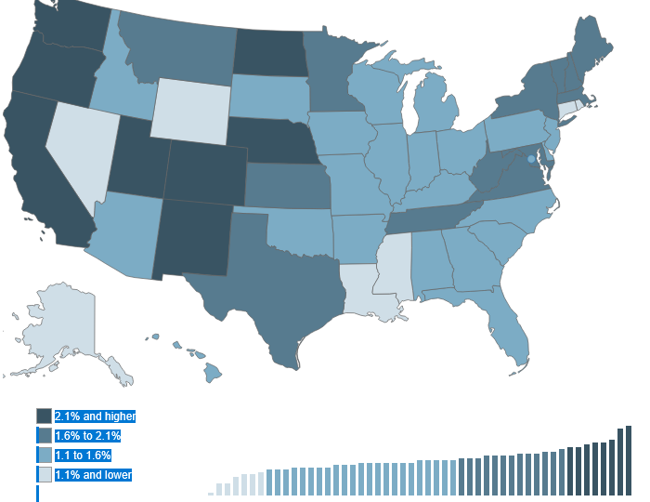
Productivity, Annual Percentage Change, 2017-2025
Source: Office of Productivity and Technology, Bureau of Labor Statistics
0.5%

Slide 50
 | State Gross Domestic Product Growth in Inflation Adjusted $ ( Millions of Chained 2017 $)
 | % CHANGE |  | REAL GDP (IN BILLIONS) CHANGE
Industry | 2012-2024 |  | 2012-2024
 | Louisiana | South Carolina | Louisiana | South Carolina
Mining | -9.6% | 254% | -$1,240 | $442
Manufacturing | 0.6% | 22% | $279 | $6,843
Wholesale Trade | -5.5% | 37% | -$676 | $3,985
Retail Trade | 28.1% | 79% | $4,026 | $9,955
Information | 43.3% | 150% | $1,765 | $5,900
Professional and Business Services | 23.4% | 72% | $4,666 | $14,094
Healthcare and Social Assistance | 39.2% | 58% | $6,234 | $7,089
Leisure and Hospitality | 3.1% | 44% | $316 | $3,936

Slide 51
Percentage Change in Real Value-Added Output Per Worker Over Time
Source: Office of Productivity and Technology, Bureau of Labor Statistics

Slide 52
Percentage Increase in Value-Added per Worker in Gross State Product
2007 - 2024
Current $
Value-added Per Worker Increase
in State Gross Product
2007 – 2024
Current $
Tennessee | 159.1%
Mississippi | 83.6%
South Carolina | 83.1%
Alabama | 73.9%
Texas | 73.5%
Florida | 70.1%
North Carolina | 69.2%
Georgia | 68.5%
Virginia | 67.4%
Arkansas | 67.0%
South | 66.8%
Louisiana | 49.6%
Texas | $142,054
Virginia | $69,271
Georgia | $67,213
Tennessee | $66,761
North Carolina | $64,818
Mississippi | $64,433
South | $63,721
Florida | $61,611
Alabama | $54,108
South Carolina | $53,525
Arkansas | $53,277
Louisiana | $52,470
Source: Annual Labor Productivity by State, Bureau of Labor Statistics (May 2025)
Calculated Percentage Change and Growth in Value-Added Per Worker by Systems Solutions Consulting

Slide 53
Example of the Problem: Labor Productivity Index
OVER the 2007 to 2024 period by State
Average Annual % Change in the Labor Productivity Index Over 2008-2025
Tennessee | 1.8
Texas | 1.7
Virginia | 1.6
South | 1.6
South Carolina | 1.5
Alabama | 1.5
Florida | 1.4
Arkansas | 1.4
Georgia | 1.4
North Carolina | 1.3
Mississippi | 1.0
Louisiana | 0.5
Annual Median % Change of Labor Productivity Index Over 2008-2025
Tennessee | 2.2
Texas | 1.7
Georgia | 1.6
South Carolina | 1.4
Virginia | 1.4
South | 1.4
Alabama | 1.1
Florida | 1.1
North Carolina | 1.1
Mississippi | 0.9
Arkansas | 0.9
Louisiana | 0.3
The Problem for Louisiana:
Median Change in the Productivity index over the 2008 to 2025 period was 0.3%

Slide 54
Unit Labor Cost: an important variable to consider
Unit labor Cost is not a problem as long a productivity rises commensurate to increase in labor costs

Slide 55
Unit Labor Costs Increase between 2017 and 2025 by Select State
Source: office of Technology and Productivity, Bureau of Labor Statistics
Percentage Change in Unit Labor Costs
Alabama | 39%
Arkansas | 42%
Florida | 49%
Georgia | 42%
Louisiana | 53%
Mississippi | 41%
North Carolina | 49%
South | 38%
South Carolina | 44%
Tennessee | 30%
Texas | 30%
Virginia | 31%
Unit Labor Cost Defined- Ratio of labor compensation per hour divided by product output per hour expressed in current dollars. Compensation/output = unit labor cost
Note: Louisiana has the highest increase in Unit Labor Costs in the sample

Slide 56
New Orleans-Metairie-Kenner MSA Outlook: An Economy in Trouble
Key Words:
MSA Job and Wealth Creation Economy Faltering:
Professional and Technical Services Job Growth:
Stagnating Since 2021
Less and Less Industry Diversity and
Occupational Diversity
MSA Population Growth Continues it Downward Spiral
and Particularly Orleans Parish
Only Population Growth Occurring in New Northshore MSA: Slidell-Manderville-Covington MSA

Slide 57
Latest data shows New Orleans-Metairie-Kenner MSA private sector job growth is struggling to recover to pre-Covis levels.
Still down by 22,600 private sector jobs in January 2026 compared to February 2020 pre-Covid job level.
Data Excludes St. Tammany Parish MSA

Slide 60
New Orleans-Metairie-Kenner MSA |  | Total Non-Farm Jobs | Total Non-Farm Jobs August 2005
Non-Farm Non-Seasonally Adjusted Jobs
August 2025 to August 2026 |  | August 2026
Construction | 2,300 | 26,200 | 25,400
All Government | 2,100 | 55,700 | 90,700
Health Care and Social Assistance | 1,900 | 68,100 | 62,200
Professional and Business Services | 900 | 63,300 | 65,700
Wholesale Trade | 100 | 17,400 | 22,500
Manufacturing | 100 | 26,100 | 38,000
Financial Activities | -100 | 23,500 | 29,000
Mining | -100 | 1,700 | 7,900
Transportation, Warehousing & Utilities | -500 | 24,300 | 25,700
Information | -500 | 5,000 | 8,900
Private Educational Services | -700 | 29,800 | 17,600
All Others | -800 | 20,500 | 10,400
Retail Trade | -900 | 42,400 | 55,500
Leisure and Hospitality | -2,500 | 66,300 | 76,100
Total Change | 1,300 | 470,300 | 535,600
Source: Bureau of Labor Statistics, Does not include Slidell, Manderville, Covington MSA

Slide 61
GDP Measured in Inflation Adjusted $ for the New Orleans MSA and Birmingham MSA:
Note impact of Covid on New Orleans MSA

Slide 62
Current Job Levels for Jefferson, Orleans
and St. Tammany Parishes
Source: Quarterly Census of Employment and Wages
Bureau of Labor Statistics

Slide 64
Key Parish Job Levels
Source: Quarterly Census of Employment and Wages, Bureau of Labor Statistics, Actual Data, January 2007- December 2025, Model Estimates, January 2026 thru August 2026, Systems Solutions Consulting
183.7 Thousand QCEW jobs

Slide 65
Key Parish Job Levels
Source: Quarterly Census of Employment and Wages, Bureau of Labor Statistics, Actual Data, January 2007- December 2025. Model Estimates, January 2026 to August 2026, Systems Solutions Consulting
Slidell-Manderville-Covington QCEW job level in September 2022 had recovered all pre-Covid 19 lock-down jobs. August 2026 estimated job level was 9,300 greater than the pre-Covid February 2020 level.
Orleans Parish, as of August 2026, was still down by 18,600 QCEW jobs below the pre-Covid February 2020 level.
Jefferson Parish, as of August 2026, was down by 7,400 QCEW jobs below the pre-Covid February 2020 Level.

Slide 66
Population Levels Labor Market Area 1
Source: U.S. Census Bureau
And Systems Solutions Consulting

Slide 67
 |  | Louisiana | Jefferson | Orleans | Plaquemines | St. Bernard | St. Charles | St. James | St. John | St. Tammany | Labor Market 1
Census | 1900 | 1,384,100 | 15,321 | 287,104 | 13,039 | 5,031 | 9,072 | 20,197 | 12,330 | 13,335 | 375,429
 | 1910 | 1,667,000 | 18,247 | 339,075 | 12,524 | 5,277 | 11,207 | 23,009 | 14,338 | 18,917 | 442,594
 | 1920 | 1,813,000 | 21,563 | 387,219 | 10,194 | 4,968 | 8,586 | 21,228 | 11,896 | 20,645 | 486,299
 | 1930 | 2,105,000 | 40,032 | 458,762 | 9,608 | 6,512 | 12,111 | 15,338 | 14,078 | 20,929 | 577,370
 | 1940 | 2,370,000 | 50,427 | 494,537 | 12,318 | 7,280 | 12,321 | 16,596 | 14,766 | 23,624 | 631,869
 | 1950 | 2,697,000 | 103,873 | 570,445 | 14,239 | 11,087 | 13,363 | 15,334 | 14,861 | 26,988 | 770,190
 | 1960 | 3,260,000 | 208,769 | 627,525 | 22,545 | 32,186 | 21,219 | 18,369 | 18,439 | 38,643 | 987,695
 | 1970 | 3,644,637 | 337,568 | 593,471 | 25,225 | 51,185 | 29,550 | 19,733 | 23,813 | 63,585 | 1,144,130
 | 1980 | 4,223,101 | 454,592 | 557,515 | 26,049 | 64,097 | 37,259 | 21,495 | 31,924 | 110,869 | 1,303,800
 | 1990 | 4,219,973 | 448,306 | 496,938 | 25,575 | 66,631 | 42,437 | 20,879 | 39,996 | 144,508 | 1,285,270
 | 2000 | 4,468,886 | 455,466 | 484,674 | 26,757 | 67,229 | 48,072 | 21,216 | 43,044 | 191,268 | 1,337,726
Census Estimates | 1-Jul-01 | 4,477,875 | 453,154 | 487,363 | 27,029 | 68,028 | 48,461 | 21,291 | 43,580 | 195,622 | 1,344,528
 | 1-Jul-02 | 4,497,267 | 453,429 | 489,722 | 27,462 | 68,964 | 49,117 | 21,365 | 43,878 | 200,701 | 1,354,638
 | 1-Jul-03 | 4,521,042 | 454,533 | 492,187 | 28,169 | 69,621 | 49,338 | 21,274 | 44,316 | 205,708 | 1,365,146
 | 1-Jul-04 | 4,552,238 | 456,602 | 493,765 | 29,390 | 70,547 | 49,939 | 21,229 | 44,822 | 211,405 | 1,377,699
 | 1-Jul-05 | 4,576,628 | 456,554 | 494,294 | 29,558 | 71,300 | 50,670 | 21,399 | 45,296 | 217,358 | 1,386,429
 | 1-Jul-06 | 4,302,665 | 426,285 | 230,172 | 22,329 | 16,563 | 52,453 | 21,964 | 47,296 | 223,133 | 1,040,195
 | 1-Jul-07 | 4,375,581 | 432,683 | 268,751 | 22,709 | 23,613 | 52,765 | 22,164 | 47,386 | 226,294 | 1,096,365
 | 1-Jul-08 | 4,435,586 | 431,759 | 301,842 | 22,677 | 28,879 | 52,516 | 22,095 | 46,811 | 229,252 | 1,135,831
 | 1-Jul-09 | 4,491,648 | 431,921 | 327,803 | 22,730 | 32,878 | 52,719 | 22,231 | 46,336 | 231,224 | 1,167,842
Census | 2010 | 4,533,372 | 432,552 | 343,829 | 23,042 | 35,897 | 52,780 | 22,102 | 45,924 | 233,740 | 1,189,866
Census Estimates | 1-Jul-10 | 4,544,996 | 432,755 | 347,903 | 23,123 | 36,813 | 52,844 | 22,006 | 45,624 | 234,568 | 1,195,636
 | 1-Jul-11 | 4,575,625 | 434,089 | 360,735 | 23,582 | 39,516 | 52,390 | 21,784 | 45,066 | 236,846 | 1,214,008
 | 1-Jul-12 | 4,600,972 | 433,954 | 369,787 | 23,826 | 41,483 | 52,420 | 21,634 | 44,719 | 239,064 | 1,226,887
 | 1-Jul-13 | 4,624,527 | 434,264 | 378,637 | 23,509 | 43,430 | 52,614 | 21,607 | 43,570 | 241,953 | 1,239,584
 | 1-Jul-14 | 4,644,013 | 434,078 | 383,940 | 23,304 | 44,439 | 52,678 | 21,515 | 43,714 | 245,237 | 1,248,905
 | 1-Jul-15 | 4,664,628 | 435,175 | 389,742 | 23,437 | 45,421 | 52,572 | 21,481 | 43,523 | 248,930 | 1,260,281
 | 1-Jul-16 | 4,678,135 | 436,572 | 391,843 | 23,323 | 45,777 | 52,796 | 21,433 | 43,401 | 252,468 | 1,267,613
 | 1-Jul-17 | 4,670,560 | 436,126 | 391,493 | 23,348 | 46,110 | 52,620 | 21,380 | 43,328 | 255,921 | 1,270,326
 | 1-Jul-18 | 4,659,690 | 433,884 | 391,004 | 23,385 | 46,780 | 52,775 | 21,151 | 43,119 | 258,035 | 1,270,133
 | 1-Jul-19 | 4,648,794 | 432,493 | 390,144 | 23,197 | 47,244 | 53,100 | 21,096 | 42,837 | 260,419 | 1,270,530
Census | 2020 | 4,657,757 | 440,781 | 383,997 | 23,515 | 43,764 | 52,549 | 20,192 | 42,477 | 264,570 | 1,271,845
 | 1-Jul-21 | 4,627,971 | 434,206 | 377,547 | 23,312 | 44,333 | 52,480 | 19,796 | 42,107 | 270,188 | 1,263,969
 | 1-Jul-22 | 4,593,687 | 427,739 | 370,473 | 22,603 | 44,474 | 51,038 | 19,397 | 39,938 | 273,494 | 1,249,156
 | 1-Jul-23 | 4,588,071 | 425,657 | 365,167 | 22,356 | 44,645 | 50,547 | 19,218 | 39,615 | 275,801 | 1,243,006
 | 1-Jul-24 | 4,597,740 | 427,253 | 362,701 | 22,289 | 44,783 | 50,400 | 19,110 | 39,694 | 277,615 | 1,243,845
 | 1-July-25 | 4,618,189 | 431,398 | 362,154 | 22,256 | 45,642 | 50,586 | 18,938 | 39,875 | 279,108 | 1,249,957
 | Source: U.S. Census Bureau; Systems Solutions Consulting

Slide 68
City of New Orleans
Population Estimates and Census 1920 to 2026
Source: U.S. Census Bureau
And Systems Solutions Consulting

Slide 69
Multiple Sources and Notes: Years 1920, 1930, 1960, 2000, 2010 and 2020 are April 1 actual U.S. Census data counts. Years 2011-2019 reflect July 1 estimates of the U.S. Census Bureau. Years 2015 to 2019 of the 2011 to 2019 data series reflect adjustments made by Systems Solutions Consulting to Census Bureau estimates to reflect the population trend toward 2020 U.S. Census Bureau April 1 actual population count. The years 2021-2025 reflect the continuation of July 1 Census estimates. The year 2026 reflects Systems Solutions regression model estimate. Specifically, the population estimate is for August 2026. Current Census time series covers the period 2006 to 2025. The Census model was updated in March 2026 with the inclusion of July 2025 data from the U.S. Census Bureau. All data estimates from the Systems Solutions model for the non-Census Bureau data period is based upon monthly postal survey data as one input. Postal survey data are gathered from “The Data Center-New Orleans” web site https://www.datacenterresearch.org
.

Slide 70
Summary
  NATIONAL ECONOMIC PICTURE
  PRICE INFLATION “STICKY”… Trend is downward (however)…Tariffs create background to negatively affect inflation rate
  INTERNATIONAL INSTABILITY-- MAJOR BACKGROUND PROBLEM TO MODERATING INFLATION
  LOUISIANA JOB RECOVERY: SLOW
    STATE GENERAL FUND REVENUE GROWTH: UNCERTAIN
    PREVIOUS GROWTH DISGUISED STRUCTURAL WEAKNESS IN STATE ECONOMY
    DATA SUGGESTS MAJOR ISSUES WITH PRODUCTIVITY, OUTPUT PER WORKER AND VALUE-ADDED
  NEW ORLEANS-METAIRIE-KENNER MSA ECONOMY RECOVERY: WEAK
    LEISURE AND HOSPITALITY RESTRUCTURING? … IMPACT ON LABOR DEMAND
    TECHNICAL AND SCIENTIFIC SERVICES JOB GROWTH…… WEAK
    POVERTY AND CRIME…
    LATEST POPULATION GROWTH CONTINUES STAGNATION PATH
    CENSUS BUREAU HAS REDEFINED NEW ORLEANS MSA AREA: ST.TAMMANY PARISH REMOVED; THIS RESULTED IN NEW ORLEANS-METARIE-KENNER MSA POPULATION FALLING TO LESS THAN ONE MILLION POPULATION

