Slide 1
May 2026
Economic Overview www. GNODATACENTER.COM
CURRENT ASSESSMENT OF U.S., LOUISIANA, NEW ORLEANS MSA and CITY OF NEW ORLEANS
Prepared By
Dr. Raymond J. Brady
Systems SOLUTIONS
CONSULTING

Slide 2
May Update of the
U.S. 2026 Economic Outlook:
Key Words:
Economic and Policy Uncertainty
Policy Chaos
Consumer Spending: ????
Data: The Rear-View Mirror Problem

Slide 3

Annualized
Real GDP 4th Quarter 2025 (3rd Estimate) | 0.5%
Current-Dollar (annualized) | 4.2%
Real GDP 3rd Quarter 2025 (2nd Estimate) | 4.4%
Current-Dollars (annualized) | 8.2%
Source: Bureau of Economic Analysis
PCE Price Index (Change from Month Previous Year)
February 2026 | 2.8%
January 2026 | 2.8%
December 2025 | 2.9%
November 2025 | 2.8%
February 2025 | 2.8%
Source: Bureau of Economic Analysis
Percentage Change Seasonally Adjusted Expenditures in Food and Drinking Places
February 2019-February 2018 | 1.6%
February 2024-February 2023 | 1.9%
February 2026-February 2025 | 3.7%
Source: Federal Reserve Bank of St. Louis (current adjusted $)
Personal Savings as a % of Disposable Income (Seasonally Adjusted at Annual Rates)
4th Quarter 2025 | 4.0%
4th Quarter 2023 | 5.5%
4th Quarter 2019 | 6.7%
Source: Bureau of Economic Analysis
SUMMARY OF
U.S. DATA

Slide 4

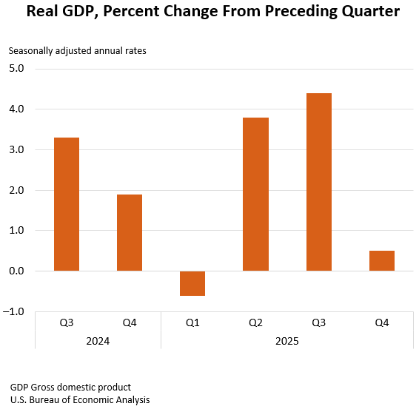
What does the 4th quarter 2025 U.S. GDP
3rd Estimate Tell Us.
Real Gross Domestic Product fell by an annualized rate of 0.5%
Real gross domestic product (GDP) increased at an annual rate of 0.5 percent in the fourth quarter of 2025 (October, November, and December), according to the third estimate released today by the U.S. Bureau of Economic Analysis.
Real GDP was revised down 0.2 percentage point from the second estimate, primarily reflecting a downward revision to investment.
The contributors to the increase in real GDP in the fourth quarter were increases in consumer spending and investment. These movements were partly offset by decreases in government spending and exports.
Imports, which are a subtraction in the calculation of GDP, decreased.

Slide 5
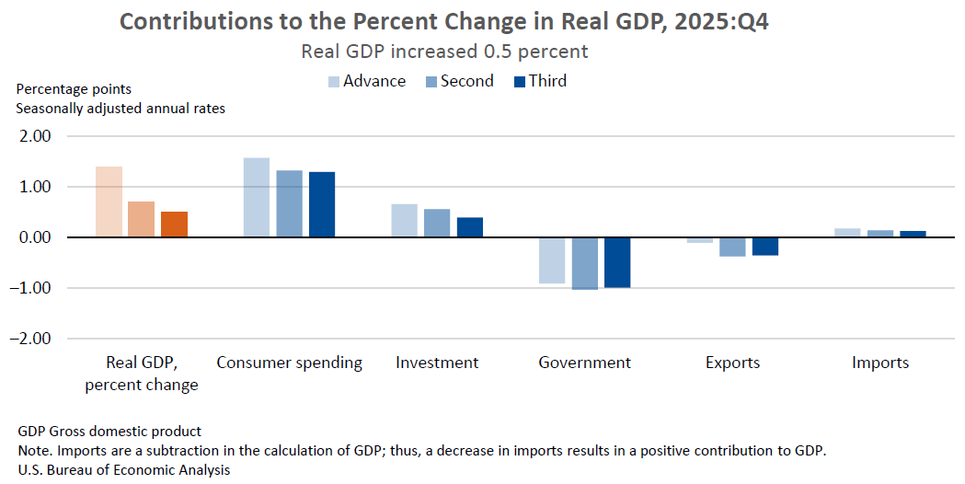
Components of Change in the 4th quarter 2025

Slide 6

Latest Survey Report from Issued AT the Federal Reserve Bank of New York on Household Consumption Expectations
March 2026
Median inflation expectations increased by 0.4 percentage point (ppt) to 3.4 percent at the one-year-ahead horizon, increased by 0.1 ppt to 3.1 percent at the three-year-ahead horizon, and were unchanged at 3.0 percent at the five-year-ahead horizon in March.
Median year-ahead commodity price change expectations increased by 5.3 ppts for gas to 9.4 percent, the highest reading since March 2022.
The mean perceived probability of finding a job if one’s current job was lost increased by 1.9 ppts to 45.9 percent; however, the mean perceived probability of losing one’s job in the next twelve months also increased by 0.6 ppt to 14.4 percent.
Perceptions about households’ current financial situations deteriorated compared to a year ago, with a larger share of households reporting a worse financial situation and a smaller share reporting a better financial situation. Year-ahead expectations about households’ financial situations also worsened, with the share of households expecting a worse financial situation at its highest level since April 2025.

Slide 7
Inflation Indices

Slide 8
CURRENT CONSUMER PRICE CHANGE
0.9% Increase in the index from
March 2025 to March 2026
Year over Year
(March 2026 Data):
Overall, Seasonally Adjusted Change
(All Urban Consumers) = 3.3%

Slide 9
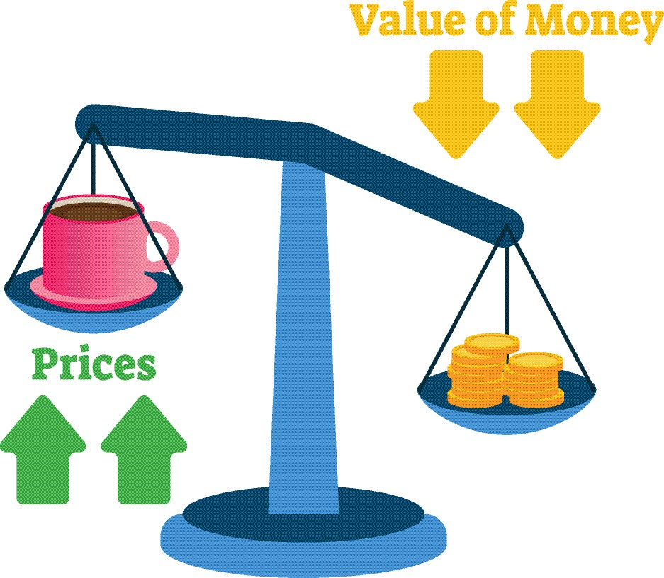

Slide 10

CPI Price Inflation:
(Non-Seasonally Adjusted Data)
Outside of Food at Home and Energy Prices Remain Sticky
March 2026 over March 2025
  All Items: 3.3% Increase
  Food at Home: 1.9% Increase
  Food Away from Home: 3.8% Increase
  Energy Commodities: 19.4%
  Energy Services: 5.0% Increase
  Shelter: 3.0% Increase
  Medical Services: 3.7% Increase
  All Items Less Food and Energy: 2.6% Increase
Twelve Month Change
Total Civilian Workers Compensation Non-Seasonally Adjusted Fourth Quarter 2025: Civilian Workers, 3.4%
Source: Bureau of Labor Statistics

Slide 11
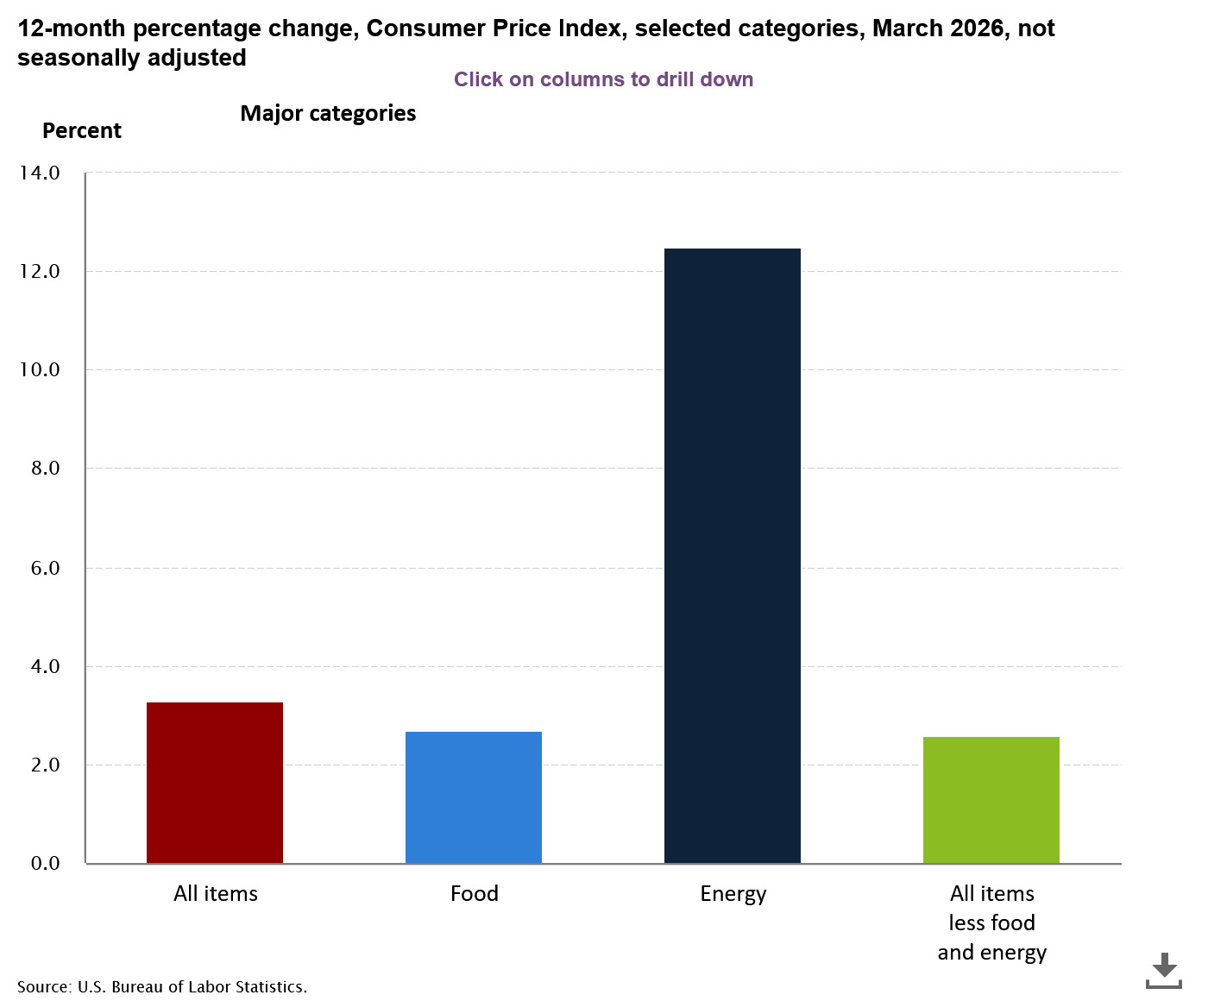
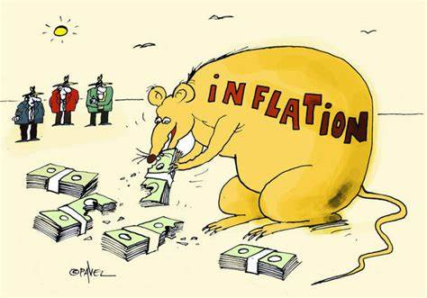

Slide 12
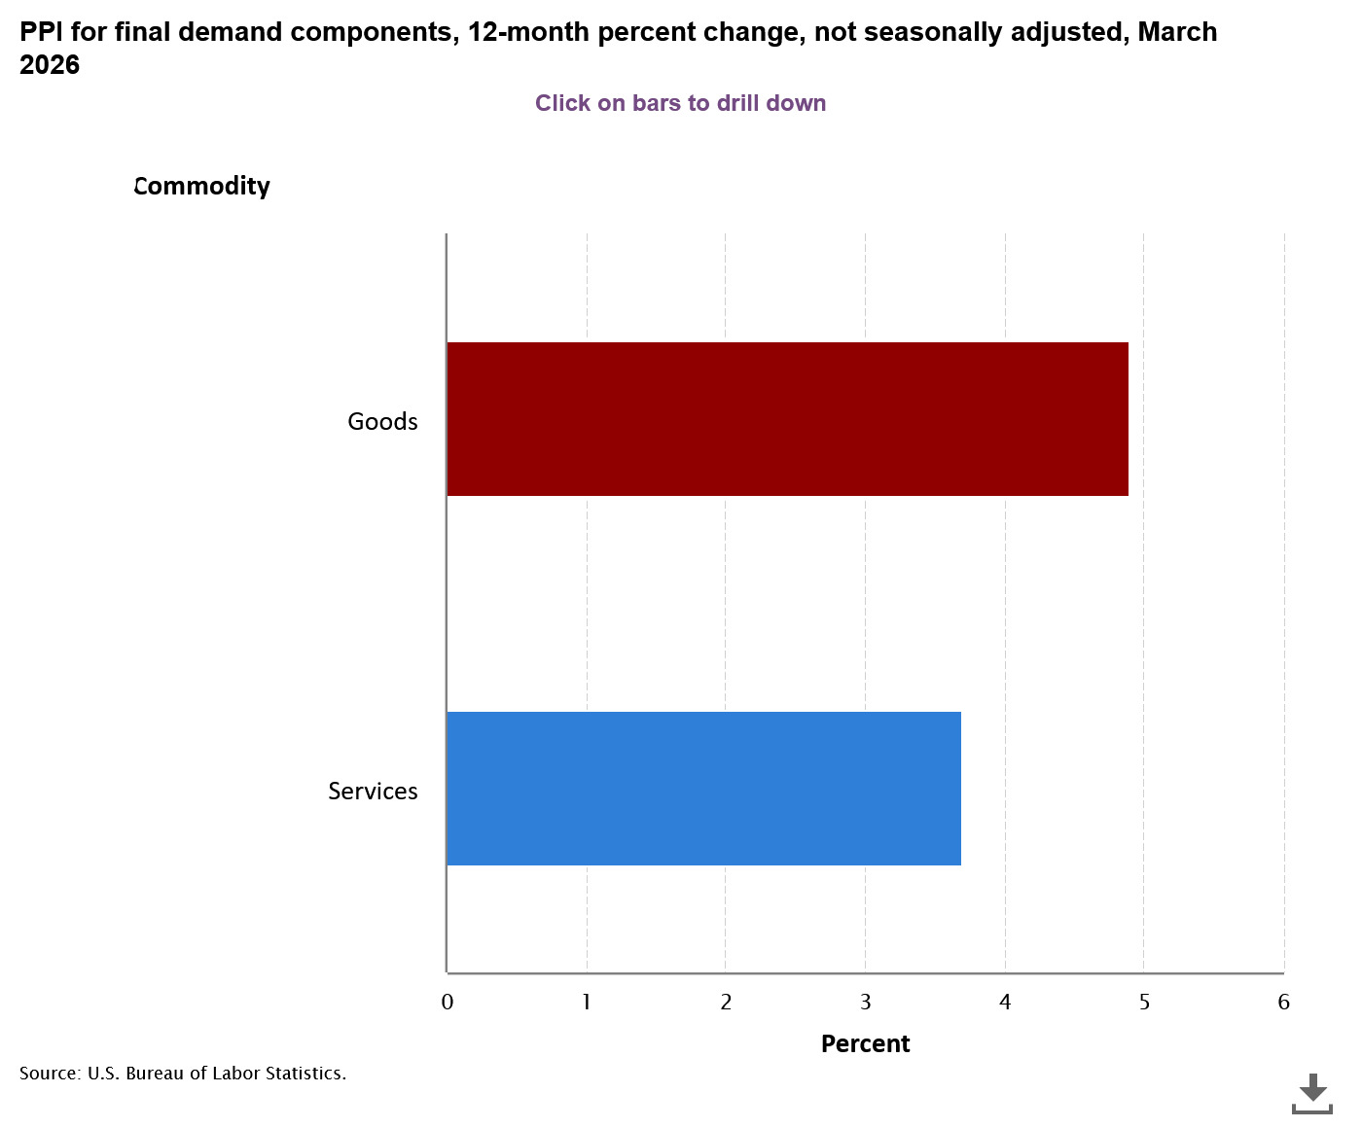
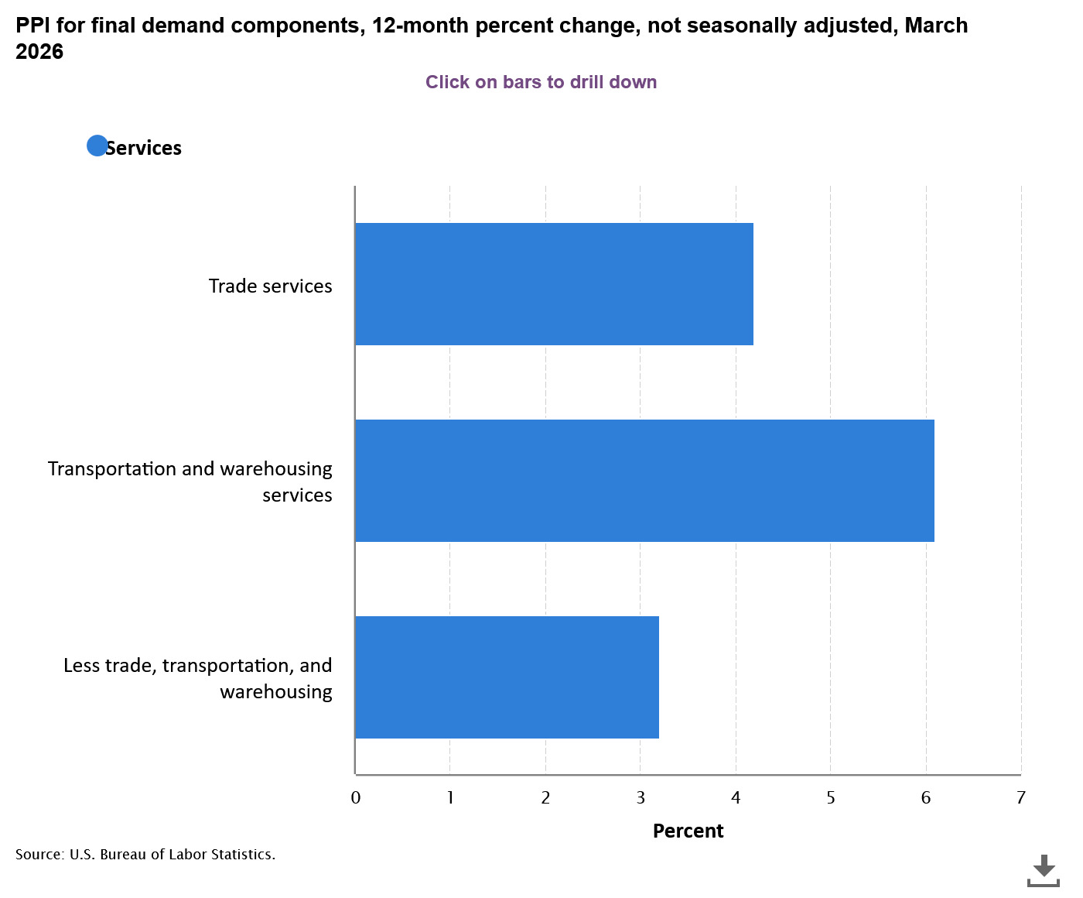
Producer Price Inflation Index:
Inflation Concentrated in Services

Slide 13
PPI Index: Peaked in March 2022
NOTE: Total driven down mostly by fall in energy prices.
Services minus trade, transportation and warehousing moving on a declining trend up to March 2026
March 2024 = 4.3%
March 2025 = 4.4%
March 2026 = 3.2%
Recent BLS “Hires and Openings” data suggest employers continue cutting back on hires.
Producer Price Index Data up to March 2026
Wage, Salary and Benefits Data Up to December 2025

Slide 14

Wage Pressure Affecting General Price Inflation
Product Supply Conditions
Labor Force Growth

Slide 15
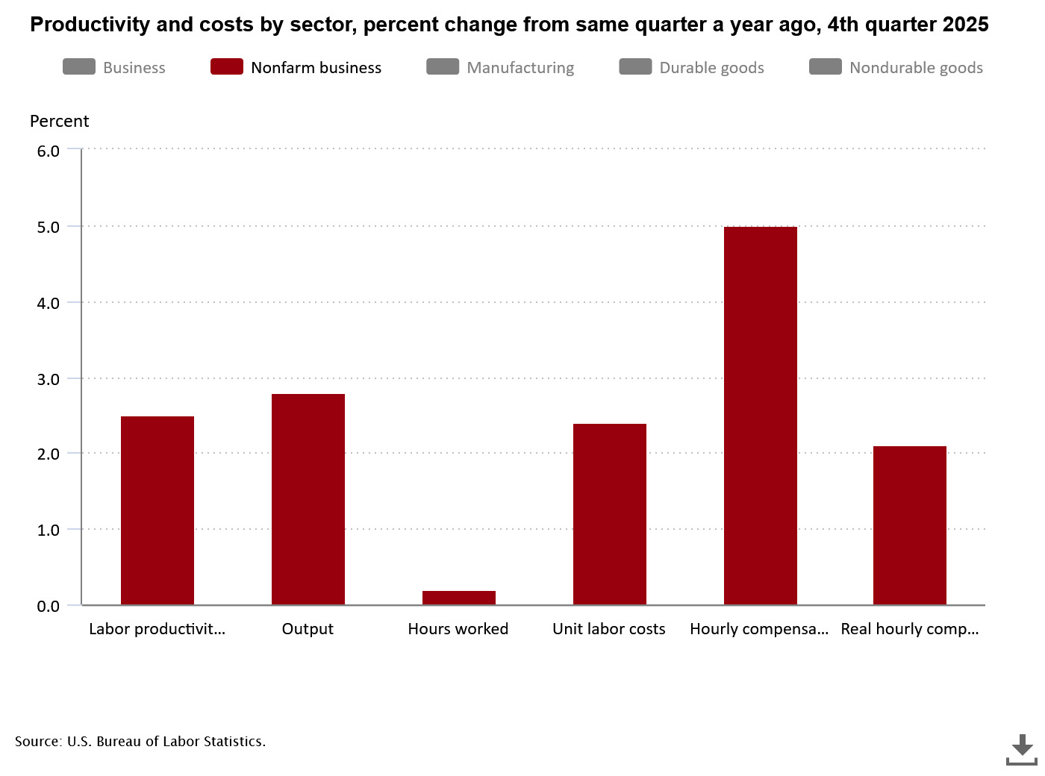
Productivity Weak
Statistics reflect change from same quarter a year ago at annualized rate
5.0%
Nonfarm business sector labor productivity increased 2.5% percent in the 4th quarter 2025 over the 4th quarter 2024
Unit labor costs in the nonfarm sector increased by 2.4 % in the 4th quarter 2025 over previous year quarter.
Real average hourly earnings increased by 2.1% over the same quarter in 2024.
Source: Bureau of Labor Statistics
2.8%
2.5%
2.4%
2.1%
0.2%

Slide 16
Total compensation
All Civilian workers in All industries and occupations, 12-month percent change
Inflationary Pressure:
Private Sector Compensation:
December 2025 over December 2024 = 3.3% (Source: BLS)
TOTAL COMPENSATION FOR PRIVATE Industries AND OCCUPATIONS,
12-MONTH PERCENT CHANGE in Current $
Source: Bureau of Labor Statistics

Slide 17
Weakening of Major Manufacturing and Service Industries Indices Pointing to a “potential” Stall in Growth

Slide 18
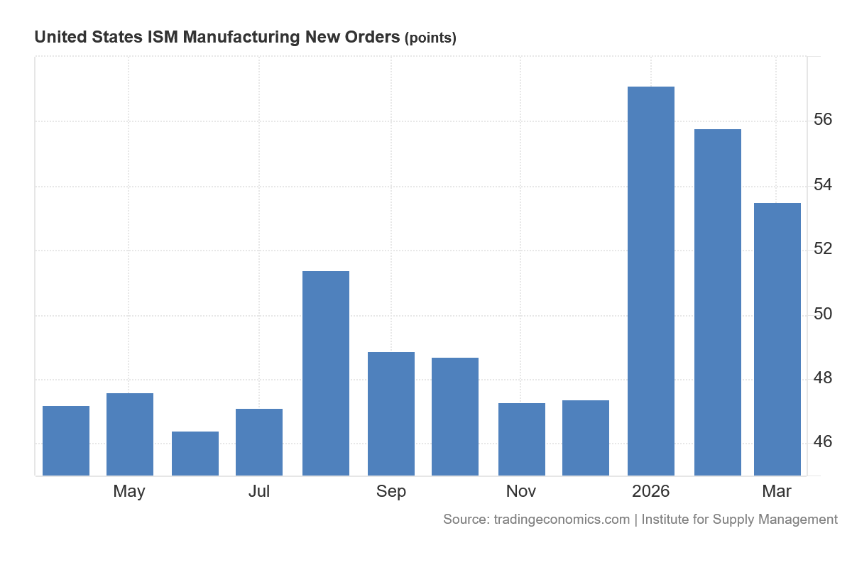
Manufacturing Purchasing Managers New Orders Index
Manufacturers Purchasing Managers New Orders Index (PMI) in March 2026 was 53.5
Source: tradingeconommics.com
A PMI reading above 50 percent indicates that the manufacturing economy is generally expanding; below 50 percent indicates that it is generally declining.

Slide 19
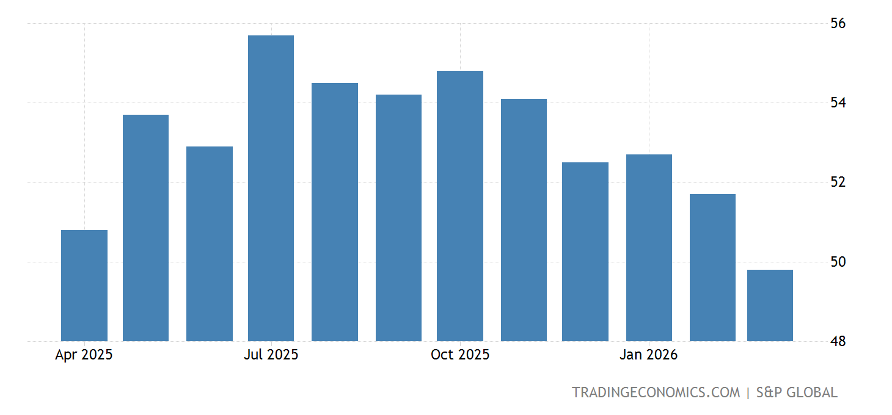
Weakening Growth
To quote the “Trading Economics” Report:
“ The S&P Global US Services PMI fell to 49.8 in March 2026.”
“The S&P Global US Services PMI fell to 49.8 in March of 2026 from 51.7 in the previous month, revised lower from the preliminary estimate of 51.1, signaling the first contraction in the sector in over three years. The decline came amid the weakest growth in new business since April 2024, as firms cited reduced client confidence and softer demand, partly linked to the impact of the Middle East conflict. Export activity also deteriorated further, with tariffs and geopolitical tensions weighing on trade. Business sentiment weakened to a five-month low as rising energy costs raised concerns over inflation and consumer spending. Employment edged lower for the first time since December, reflecting caution among firms. Input cost inflation accelerated to its highest level this year, driven largely by higher energy prices.”
: S&P Global
Services Purchasing Managers Index (PMI)
Source: Trading Economics

Slide 20
Independent Data Still Finds Bottlenecks in Finding Skilled Labor

Slide 21
Hires in February 2026, in absolute terms, the lowest since February 2015
Layoffs and discharges have stabilize
As of February 2026, there were 0.74 job openings for every unemployed (non-seasonally adjusted data)
Potential Consequences: rapid slowdown in hiring
Excess aggregate Labor downward pressure on wage increase

Slide 22
The Job and Labor Force Situation

Slide 23
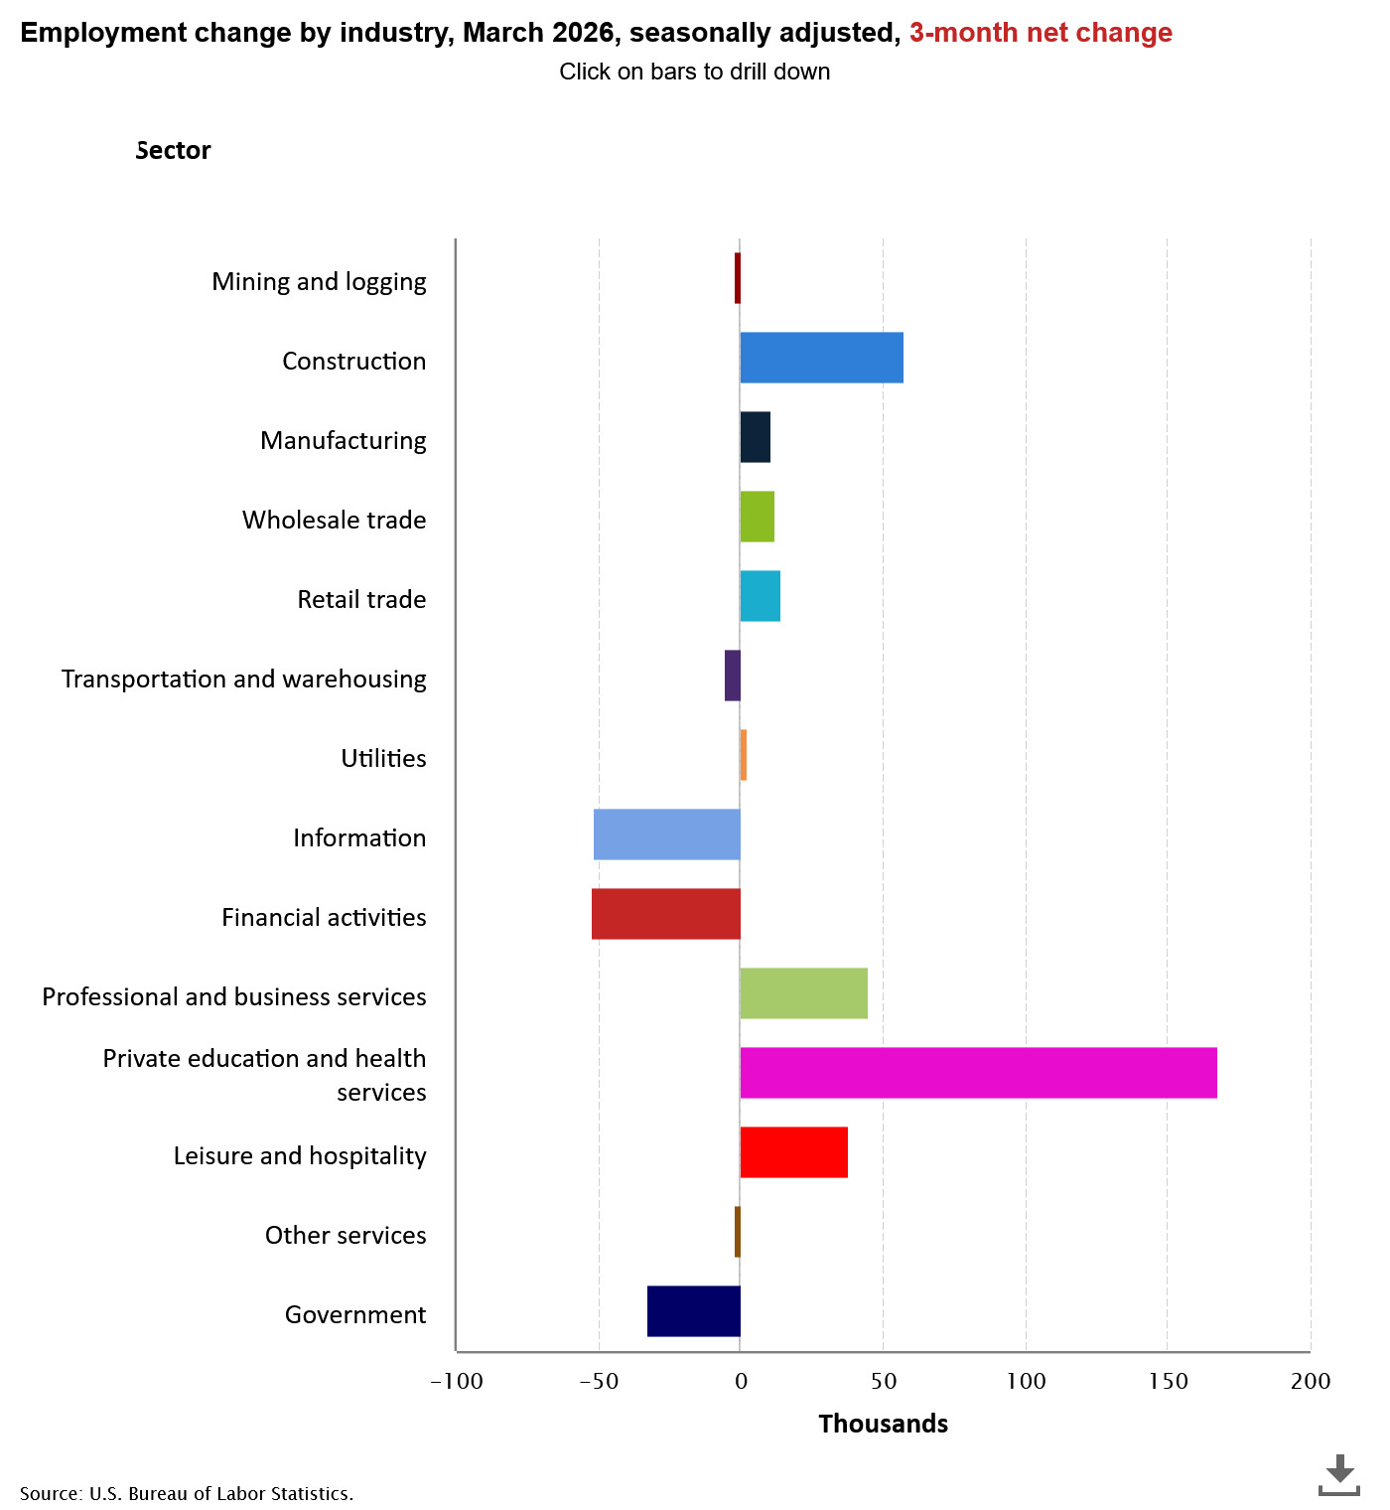
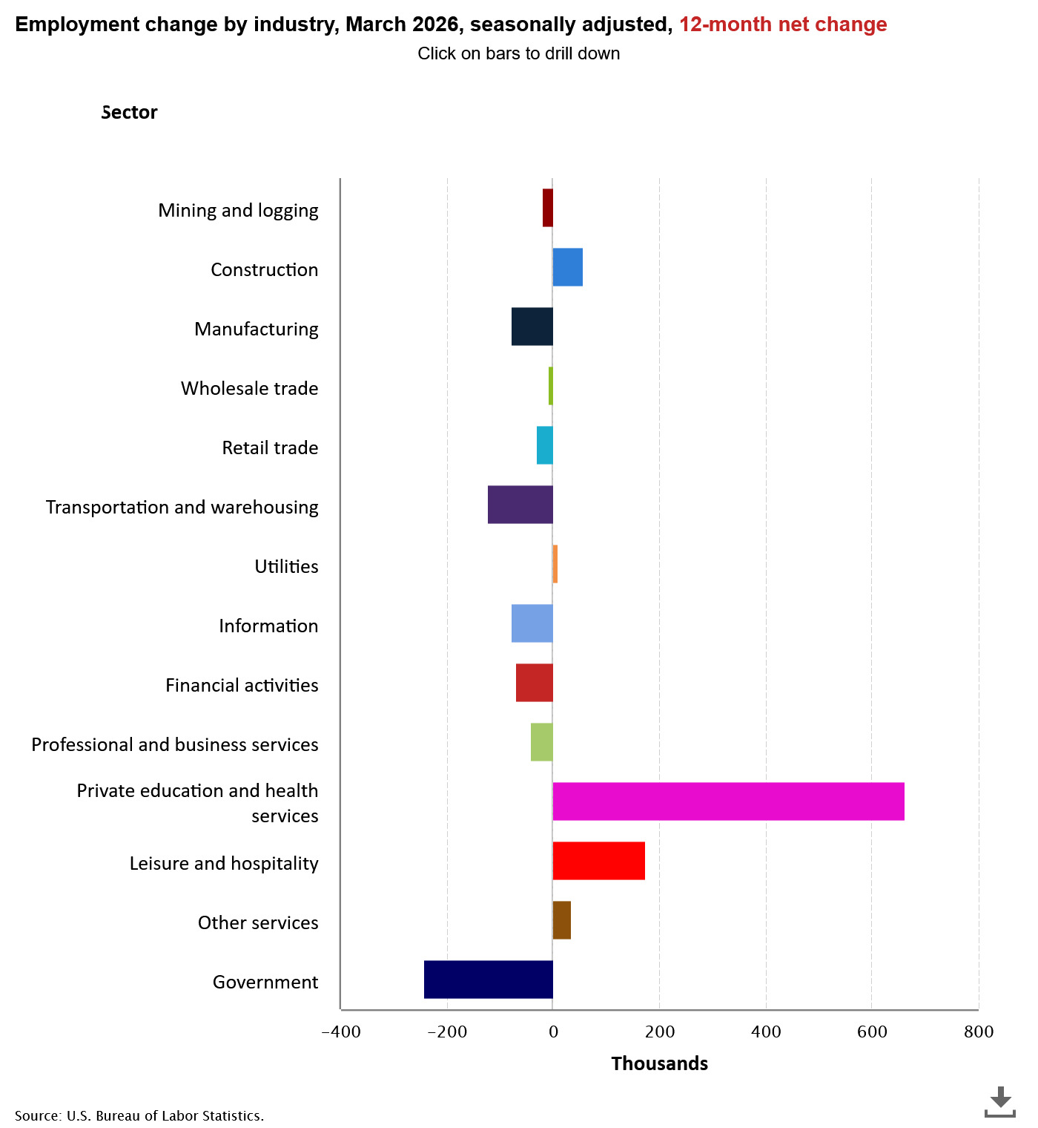
U.S. Employment Change Viewed
From A three-month and a twelve-month Change

Slide 24
Year 2008 indicates Participation Rate Pattern Change
Primary Causes…
Population aging, and Decline in the number of people who want to work
(source: National Bureau of Economic Research, “Declining Desire to work and Downward Trends in Unemployment and Participation,” Working Paper 21252, June 2015)

Slide 25
The Problem:
Stagnation (see above chart) in Labor force Growth likely limiting Potential Job Growth?
Adjusted for Price Inflation, long term Real Potential Personal Income Growth LESS than trend
116574.3
438.8672

Slide 26
A Closer Look At Accommodations and Food Services In Leisure and Hospitality
Total U.S. (seasonally adjusted) Employment in Accommodations and Food Services was still 38 thousand fewer in March 2026 than the previous employment high point of December 2019 (14,336 million jobs). (Source: BLS)
1
However, if measured on an annual average basis (2026 reflects three months of data), U.S. Accommodations and Food Services was 135 thousand greater in 2026 than in 2019. (Source: BLS) seasonally adjusted
2
In Accommodations and Foods Service in February 2026:
Opening = 689 thousand jobs.
Hires =602 thousand
Layoffs = 177 thousand.
(all data are non-seasonally adjusted)
3

Slide 27
The National Unemployment Situation
Percent unemployed
Source: BLS Current Population Survey
Seasonally Adjusted
Month | Total | White | Black or African American | Asian | Hispanic or Latino
Dec 2021 | 3.9 | 3.3 | 7.0 | 3.8 | 4.8
Dec 2022 | 3.5 | 3.0 | 5.7 | 2.4 | 4.1
Jan 2023 | 3.4 | 3.1 | 5.4 | 2.8 | 4.5
Jan. 2024 | 3.7 | 3.4 | 5.3 | 2.9 | 5.0
July | 4.2 | 3.8 | 6.2 | 3.6 | 5.3
December | 4.1 | 3.6 | 6.1 | 3.5 | 5.1
Jan. 2025 | 4.0 | 3.5 | 6.2 | 3.7 | 4.8
July | 4.3 | 3.7 | 7.2 | 3.9 | 5.0
Dec. 2025 | 4.4 | 3.8 | 6.9 | 3.6 | 4.8
March 2026 | 4.3 | 3.6 | 7.1 | 3.7 | 4.8

Slide 28
A SNAPSHOT OF
CONSUMER BEHAVIOR
Source: BEA and Census Bureau

Slide 29
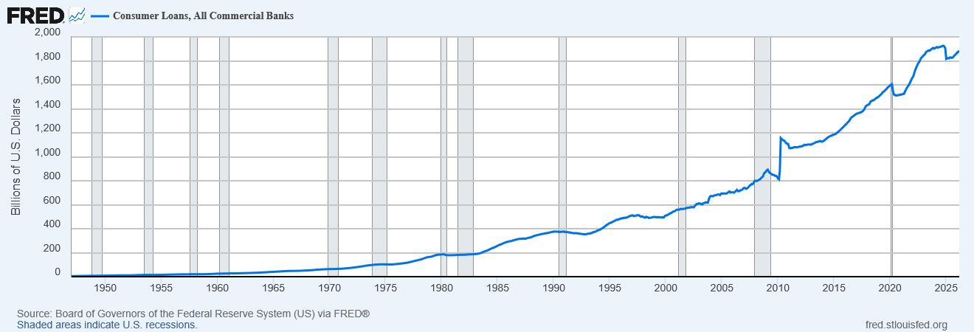
Consumer Credit Level: 1.1 Trillion $
August 2025
Loans, Credit Card and other Revolving Plans.
Savings Rate as a Percentage of Disposable Income Increasing. (recall savings rate in “Summary of U.S.” Chart)
Consumer Credit Level: $1.89 trillion
March 2026

Slide 30
Thoughts on the National Outlook
Inflation, Lots of Uncertainty…
Budget Priorities, Erratic Public Policies, Distortions in the Marketplace
Background--International Instability

Slide 31
Current Louisiana Economic Outlook:
Key Words:
  “Repeat” Concern:
  Continued Weak Job Growth
  Relative to U.S.
  Personal Income Growth Driven by
  Dividends, Interest and Rent
  Transfer Payments and Health Care
  Major Long-Term Problems with Inflation Adjusted Labor Productivity, Output and Value-Added Per Worker Growth in Louisiana: Structural Changes in the Louisiana(?)

Slide 32
Louisiana’s Annual 2025 Report
Trend In Sales Tax Collections Up
Income Tax Collections Stable

Slide 33
Snapshot of Primary Sources of Louisiana State Revenues
Note: Sales Tax Collections Reflect Broader Base of Collections and Higher Tax Rate
Values are in Current $

Slide 34
Data Shows: Louisiana Job Economy
Lagging U.S. Job Growth
Note: Dips in Data reflects Non-Seasonal Adjustment
Trend most important

Slide 35
The Reality: total number of CES non-farm jobs in Louisiana peaked (post-Hurricane Katrina) in December 2014 at 2.7% above the August 2005 level
January 2026 index reading = 102.2
August 2005 = 100

Slide 36
Source: Current Employment Survey, Bureau of Labor Statistics
STATE OF LOUISIANA |  | Total Non-Farm Employment January 2026
Non-Seasonally Adjusted Job Growth January 2025 to January 2026
Health Care and Social Assistance | 8,800 | 302,100
Manufacturing | 1,800 | 141,000
Financial Activities | 1,800 | 93,900
Private Educational Services | 1,300 | 50,800
Leisure and Hospitality | 1,200 | 222,100
Professional and Business Services | 1,200 | 220,800
Construction | 1,200 | 139,300
Government | 0 | 325,700
Wholesale Trade | -200 | 68,100
Truck Transportation | -300 | 16,500
Support Activities in Transportation | -400 | 19,600
Mining | -700 | 27,700
Information | -2,200 | 15,800
Retail Trade | -2,300 | 211,100
All Others | -7,200 | 133,700
Total Change | 4,000 | 1,988,200

Slide 37
Louisiana Leisure and Hospitality Industry: little change in hours worked, Increase in Average Pay

Slide 38
Louisiana’s Personal Income Growth in 2025 Driven by Personal Transfer Payments

Slide 39
Personal Transfer Payments as A Percentage of Total Personal Income:
Louisiana’s Personal Income Level Highly Dependent of Transfer Payments
4th quarter 2025
Transfer Payments consist of:
  Social Security Benefits
  Medicare Benefits
  Medicare Benefits
  All Other transfer Benefits
Transfer Benefits as a percentage of total Personal Income
Louisiana = 24.6%
Alabama = 24.9%
South Carolina = 24.1%
California = 17.4%
  Louisiana Transfer Benefits for Medicaid highest among selected states
    Louisiana = 5.5% of Total PI
    Alabama = 2.7% of Total PI
    South Carolina = 2.9% of Total PI
    California = 5.2% of Total PI

Slide 40
Louisiana’s Personal
Income Growth
Source: Bureau of Economic Analysis
Millions of Current $
Personal Income Change For Select Components
4th Quarter 2019 to 4th Quarter 2025
Personal income (thousands of dollars, seasonally adjusted) | $77,627
Earnings by place of work | $41,401
Plus: Personal current transfer receipts | $24,496
Wages and salaries | $29,488
Proprietors' income 8 | $6,222
Farm earnings | $183
Nonfarm earnings | $41,218
Private nonfarm earnings | $36,582
Health care and social assistance | $6,926
Professional, scientific, and technical services | $4,011
Manufacturing | $3,559
Construction | $3,471
Accommodation and food services | $1,615
Arts, entertainment, and recreation | $537
Mining, quarrying, and oil and gas extraction | -$413

Slide 41
Louisiana
Description | 2019: Q1 | 2020:Q1 | 2022: Q4 | 2024:Q4 | 2025:Q4
Personal income (thousands of dollars, seasonally adjusted) Current $ | $218,081,048 | $221,684,120 | $275,886,604 | $287,105,484 | $298,536,337
Personal current transfer receipts (000) | $47,535,332 | $50,194,856 | $65,409,540 | $67,991,508 | $73,299,832
Social Security Benefits (000) | $13,954,460 | $14,543,116 | $18,248,152 | $19,310,264 | $20,628,775
Medicare benefits (000) | $11,703,880 | $12,259,136 | $16,070,836 | $17,330,840 | $19,287,166
Medicaid (000) | $11,411,976 | $12,071,120 | $16,711,972 | $15,430,260 | $16,514,200
State unemployment insurance compensation (000) | $176,072 | $593,264 | $170,952 | $151,116 | $136,893
All other personal current transfer receipts (000) | $10,288,944 | $10,728,220 | $14,207,628 | $15,769,028 | $16,732,798
Personal Current Transfers as a Fraction of Personal Income | 21.8% | 22.6% | 23.7% | 23.7% | 24.6%
Importance of Transfer Payments as a Fraction of PI
Personal Income Levels
Personal Transfer Payments
Other Transfer Payments
Note: Medicaid Growth
Source: Bureau of Economic Analysis

Slide 42
POPULATION ESTIMATES BY SOUTHERN STATE
SOURCE: U.S.CENSUS BUREAU

Slide 43
 | Population Data for Southern States
 | Alabama | Arkansas | Florida | Georgia | Kentucky | Louisiana | Mississippi | North Carolina | South Carolina | Tennessee | Texas | Virginia
2000 Census | 4,447,100 | 2,673,400 | 15,982,378 | 8,186,453 | 4,041,769 | 4,468,976 | 2,844,658 | 8,049,313 | 4,012,012 | 5,689,283 | 20,851,820 | 7,078,515
1-Jul-00 | 4,451,497 | 2,678,115 | 16,046,148 | 8,230,306 | 4,048,903 | 4,468,979 | 2,848,310 | 8,079,383 | 4,023,570 | 5,703,243 | 20,945,963 | 7,104,533
1-Jul-01 | 4,467,634 | 2,691,571 | 16,356,966 | 8,377,038 | 4,068,132 | 4,477,875 | 2,852,994 | 8,210,122 | 4,064,995 | 5,750,789 | 21,319,622 | 7,198,362
1-Jul-02 | 4,480,089 | 2,705,927 | 16,689,370 | 8,508,256 | 4,089,875 | 4,497,267 | 2,858,681 | 8,326,201 | 4,107,795 | 5,795,918 | 21,690,325 | 7,286,873
1-Jul-03 | 4,503,491 | 2,724,816 | 17,004,085 | 8,622,793 | 4,117,170 | 4,521,042 | 2,868,312 | 8,422,501 | 4,150,297 | 5,847,812 | 22,030,931 | 7,366,977
1-Jul-04 | 4,530,729 | 2,749,686 | 17,415,318 | 8,769,252 | 4,146,101 | 4,552,238 | 2,889,010 | 8,553,152 | 4,210,921 | 5,910,809 | 22,394,023 | 7,475,575
1-Jul-05 | 4,569,805 | 2,781,097 | 17,842,038 | 8,925,922 | 4,182,742 | 4,576,628 | 2,905,943 | 8,705,407 | 4,270,150 | 5,991,057 | 22,778,123 | 7,577,105
1-Jul-06 | 4,628,981 | 2,821,761 | 18,166,990 | 9,155,813 | 4,219,239 | 4,302,665 | 2,904,978 | 8,917,270 | 4,357,847 | 6,088,766 | 23,359,580 | 7,673,725
1-Jul-07 | 4,672,840 | 2,848,650 | 18,367,842 | 9,349,988 | 4,256,672 | 4,375,581 | 2,928,350 | 9,118,037 | 4,444,110 | 6,175,727 | 23,831,983 | 7,751,000
1-Jul-08 | 4,718,206 | 2,874,554 | 18,527,305 | 9,504,843 | 4,289,878 | 4,435,586 | 2,947,806 | 9,309,449 | 4,528,996 | 6,247,411 | 24,309,039 | 7,833,496
1-Jul-09 | 4,757,938 | 2,896,843 | 18,652,644 | 9,620,846 | 4,317,074 | 4,491,648 | 2,958,774 | 9,449,566 | 4,589,872 | 6,306,019 | 24,801,761 | 7,925,937
2010 Census | 4,779,736 | 2,915,918 | 18,801,310 | 9,687,653 | 4,339,367 | 4,533,372 | 2,967,297 | 9,535,483 | 4,625,364 | 6,346,105 | 25,145,561 | 8,001,024
1-Jul-10 | 4,785,514 | 2,921,998 | 18,846,143 | 9,712,209 | 4,348,464 | 4,544,635 | 2,970,615 | 9,574,586 | 4,635,846 | 6,355,518 | 25,241,897 | 8,024,004
1-Jul-11 | 4,788,095 | 2,921,546 | 18,842,405 | 9,712,616 | 4,349,159 | 4,544,804 | 2,970,367 | 9,571,037 | 4,633,669 | 6,400,298 | 25,645,504 | 8,102,437
1-Jul-12 | 4,812,576 | 2,938,773 | 19,036,879 | 9,805,666 | 4,374,302 | 4,577,089 | 2,977,902 | 9,641,131 | 4,661,744 | 6,356,388 | 25,238,386 | 8,025,105
1-Jul-13 | 4,839,947 | 2,948,793 | 19,268,256 | 9,907,250 | 4,394,147 | 4,603,590 | 2,982,356 | 9,719,755 | 4,699,358 | 6,404,657 | 25,627,909 | 8,107,953
1-Jul-14 | 4,865,253 | 2,954,563 | 19,502,928 | 9,980,892 | 4,415,978 | 4,628,239 | 2,986,599 | 9,800,429 | 4,738,067 | 6,463,610 | 26,052,403 | 8,197,400
1-Jul-15 | 4,887,757 | 2,961,050 | 19,790,139 | 10,078,133 | 4,428,854 | 4,648,813 | 2,987,656 | 9,876,774 | 4,789,723 | 6,508,290 | 26,433,846 | 8,270,221
1-Jul-16 | 4,909,177 | 2,970,210 | 20,140,379 | 10,191,912 | 4,443,778 | 4,670,550 | 2,985,000 | 9,962,464 | 4,850,136 | 6,559,452 | 26,903,208 | 8,334,206
1-Jul-17 | 4,931,579 | 2,980,475 | 20,533,473 | 10,318,636 | 4,457,755 | 4,685,576 | 2,984,364 | 10,072,775 | 4,908,404 | 6,613,679 | 27,394,564 | 8,390,494
1-Jul-18 | 4,953,096 | 2,990,702 | 20,868,335 | 10,428,854 | 4,475,829 | 4,678,580 | 2,983,448 | 10,172,498 | 4,963,742 | 6,673,101 | 27,825,975 | 8,445,270
1-Jul-19 | 4,977,088 | 2,997,195 | 21,131,181 | 10,532,841 | 4,487,302 | 4,670,033 | 2,974,657 | 10,273,864 | 5,019,607 | 6,740,060 | 28,188,852 | 8,503,046
1-Jul-20 | 4,921,532 | 3,030,522 | 21,733,312 | 10,710,017 | 4,477,251 | 4,645,318 | 2,966,786 | 10,600,823 | 5,218,040 | 6,806,981 | 28,508,309 | 8,547,370
2020 Census | 5,024,279 | 3,011,524 | 21,538,187 | 10,711,908 | 4,505,836 | 4,657,757 | 2,961,279 | 10,439,388 | 5,118,425 | 6,910,840 | 29,145,505 | 8,631,393
1-Jul-21 | 5,050,058 | 3,027,127 | 21,836,698 | 10,793,038 | 4,508,348 | 4,628,595 | 2,947,603 | 10,565,503 | 5,194,346 | 6,966,687 | 29,572,672 | 8,660,007
1-Jul-22 | 5,076,868 | 3,047,429 | 22,413,989 | 10,929,992 | 4,521,238 | 4,600,892 | 2,941,237 | 10,705,768 | 5,288,957 | 7,063,325 | 30,118,002 | 8,681,038
1-Jul-23 | 5,117,850 | 3,069,856 | 22,929,248 | 11,063,669 | 4,549,953 | 4,598,777 | 2,942,470 | 10,871,849 | 5,390,798 | 7,153,029 | 30,719,247 | 8,732,034
1-Jul-24 | 5,163,055 | 3,096,080 | 23,265,838 | 11,204,208 | 4,584,046 | 4,614,878 | 2,950,172 | 11,052,061 | 5,490,316 | 7,251,291 | 31,318,578 | 8,819,642
1-Jul-25 | 5,193,088 | 3,114,791 | 23,462,518 | 11,302,748 | 4,606,864 | 4,618,189 | 2,954,160 | 11,197,968 | 5,570,274 | 7,315,076 | 31,709,821 | 8,880,107
% Change 2000 to 2025 | 16.8% | 16.5% | 46.8% | 38.1% | 14.0% | 3.3% | 3.8% | 39.1% | 38.8% | 28.6% | 52.1% | 25.5%

Slide 44
The Most Worrisome Problem
Structural Changes in Louisiana’s Economy have Created Long Term
Competitive Problems with
Labor Productivity
Output Per Worker
Value-Added and Wealth Creation
Full report found on gnodatacenter.com working paper #3

Slide 45
Definitions
Labor productivity - measures the hourly output of an economy. Specifically, it charts the amount of real gross domestic product (GDP) produced by an hour of labor. Growth in labor productivity depends on three main factors: saving and investment in physical capital, new technology, and human capital.
Output Per Worker- A measure of productivity calculated by dividing the total output by the number of workers.
Real value-added output - removing the effect of price level changes from the nominal value of a good, service, or time-series data, to obtain a truer picture of economic trends.

Slide 46
Louisiana’s Economy is Going Backwards in Key Areas
Year 2017= 100

Slide 47
Louisiana’s Economy is Going Backwards in Key Areas
Year 2017 = 100
99.0

Slide 49
YOU CANNOT BUILD A STRONG ECONOMY
WITH THESE TYPE OF STATISTICS:
LOUISIANA IN ECONOMIC CRISIS:
Louisiana is Not Successfully Competing
Example: Louisiana vs South Carolina

Slide 50
 | State Gross Domestic Product Growth in Inflation Adjusted $ ( Millions of Chained 2017 $)
 | % CHANGE |  | REAL GDP (IN BILLIONS) CHANGE
Industry | 2012-2024 |  | 2012-2024
 | Louisiana | South Carolina | Louisiana | South Carolina
Mining | -9.6% | 254% | -$1,240 | $442
Manufacturing | 0.6% | 22% | $279 | $6,843
Wholesale Trade | -5.5% | 37% | -$676 | $3,985
Retail Trade | 28.1% | 79% | $4,026 | $9,955
Information | 43.3% | 150% | $1,765 | $5,900
Professional and Business Services | 23.4% | 72% | $4,666 | $14,094
Healthcare and Social Assistance | 39.2% | 58% | $6,234 | $7,089
Leisure and Hospitality | 3.1% | 44% | $316 | $3,936

Slide 51
Percentage Change in Real Output Per Worker Over Time
 | Change 2007- 2024 | Change 2007-2012 | Change 2012-2024
Alabama | 118% | 19% | 83%
Arkansas | 131% | 18% | 97%
Florida | 131% | 18% | 97%
Georgia | 154% | 11% | 128%
Louisiana | 68% | 17% | 44%
Mississippi | 92% | 22% | 58%
North Carolina | 152% | 15% | 119%
South Carolina | 148% | 14% | 118%
Tennessee | 176% | 27% | 117%
Texas | 176% | 26% | 119%
Virginia | 152% | 21% | 108%
South | 153% | 19% | 112%
Source: Office of Productivity and Technology, Bureau of Labor Statistics

Slide 52
Percentage Increase in Value-Added per Worker in Gross State Product
2007 - 2024
Current $
Value-added Per Worker Increase
in State Gross Product
2007 – 2024
Current $
Tennessee | 159.1%
Mississippi | 83.6%
South Carolina | 83.1%
Alabama | 73.9%
Texas | 73.5%
Florida | 70.1%
North Carolina | 69.2%
Georgia | 68.5%
Virginia | 67.4%
Arkansas | 67.0%
South | 66.8%
Louisiana | 49.6%
Texas | $142,054
Virginia | $69,271
Georgia | $67,213
Tennessee | $66,761
North Carolina | $64,818
Mississippi | $64,433
South | $63,721
Florida | $61,611
Alabama | $54,108
South Carolina | $53,525
Arkansas | $53,277
Louisiana | $52,470
Source: Annual Labor Productivity by State, Bureau of Labor Statistics (May 2025)
Calculated Percentage Change and Growth in Value-Added Per Worker by Systems Solutions Consulting

Slide 53
Example of the Problem: Labor Productivity Index
OVER the 2007 to 2024 period by State
Average % Change in the Index Over 2007-2024
Virginia | 1.7
Tennessee | 1.4
Texas | 1.4
South | 1.3
Georgia | 1.3
Alabama | 1.2
Arkansas | 1.2
Florida | 1.2
North Carolina | 1.2
South Carolina | 1.2
Mississippi | 0.8
Louisiana | 0.2
Median % Change of Labor Productivity Index Over 2007- 2024
Tennessee | 1.6
Georgia | 1.5
South | 1.3
Florida | 1.3
Texas | 1.2
Alabama | 1.2
Arkansas | 1.2
North Carolina | 1.1
Virginia | 1.1
South Carolina | 0.8
Mississippi | 0.8
Louisiana | 0.6
The Problem for Louisiana:
Average Annual Median Change in the Productivity index over the 2007 to 2024 period was 0.6%

Slide 54
Unit Labor Cost: an important variable to consider
Unit labor Cost is not a problem as long a productivity rises commensurate to increase in labor costs

Slide 55
Unit Labor Costs Increase between 2012 and 2024 by Select State
Source: office of Technology and Productivity, Bureau of Labor Statistics
Percentage Change in Unit Labor Costs
Alabama | 40.5%
South Carolina | 39.8%
North Carolina | 39.0%
Florida | 38.1%
Mississippi | 38.0%
Louisiana | 36.1%
Tennessee | 34.3%
Georgia | 34.3%
South | 32.5%
Arkansas | 31.2%
Virginia | 28.0%
Unit Labor Cost Defined- Ratio of labor compensation per hour divided by product output per hour expressed in current dollars. Compensation/output = unit labor cost

Slide 56
New Orleans-Metairie-Kenner MSA Outlook: An Economy in Trouble
Key Words:
MSA Job and Wealth Creation Economy Faltering:
Professional and Technical Services Job Growth:
Stagnating Since 2021
Less and Less Industry Diversity and
Occupational Diversity
MSA Population Growth Continues it Downward Spiral
and Particularly Orleans Parish
Only Population Growth Occurring in New Northshore MSA: Slidell-Manderville-Covington MSA

Slide 57
Latest data shows New Orleans-Metairie-Kenner MSA private sector job growth is struggling to recover to pre-Covis levels.
Still down by 27,300 private sector jobs in January 2026 compared to February 2020 pre-Covid job level.
Data Excludes St. Tammany Parish MSA

Slide 60
New Orleans-Metairie-Kenner MSA |  | Total Non-Farm Jobs | Total Non-Farm Jobs August 2005
Non-Farm Non-Seasonally Adjusted Jobs
January 2025 to January 2026 |  | January 2026
Financial Activities | 500 | 23,700 | 29,000
All Government | 500 | 55,100 | 90,700
Construction | 100 | 24,300 | 25,400
All Others | 100 | 21,100 | 10,400
Wholesale Trade | 100 | 17,200 | 22,500
Health Care and Social Assistance | 0 | 65,100 | 62,200
Mining | -100 | 1,700 | 7,900
Manufacturing | -400 | 25,900 | 38,000
Transportation, Warehousing & Utilities | -600 | 25,000 | 25,700
Retail Trade | -800 | 43,100 | 55,500
Information | -900 | 4,900 | 8,900
Private Educational Services | -1,600 | 29,400 | 17,600
Professional and Business Services | -2,000 | 62,200 | 65,700
Leisure and Hospitality | -2,500 | 67,200 | 76,100
Total Change | -7,600 | 465,900 | 535,600
Note: Does not include Slidell + Manderville + Covington MSA
Source: Bureau of Labor Statistics

Slide 61
GDP Measured in Inflation Adjusted $ for the New Orleans MSA and Birmingham MSA:
Note impact of Covid on New Orleans MSA

Slide 62
Current Job Levels for Jefferson, Orleans
and St. Tammany Parishes
Source: Quarterly Census of Employment and Wages
Bureau of Labor Statistics

Slide 64
Key Parish Job Levels
Source: Quarterly Census of Employment and Wages, Bureau of Labor Statistics, Actual Data, January 2007- September 2025, Model Estimates, October 2025 thru January 2026, Systems Solutions Consulting

Slide 65
Key Parish Job Levels
Source: Quarterly Census of Employment and Wages, Bureau of Labor Statistics, Actual Data, January 2007- September 2025. Model Estimates, October 2025 to January 2026, Systems Solutions Consulting
Slidell-Manderville-Covington QCEW job level in September 2022 had recovered all pre-Covid 19 lock-down jobs. January 2026 estimated job level was 6,600 greater than the pre-Covid February 2020 level.
Orleans Parish, as of January 2026, was still down by 16,400 QCEW jobs below the pre-Covid February 2020 level.
Jefferson Parish, as of January 2026, was down by 6,900 QCEW jobs below the pre-Covid February 2020 Level.

Slide 66
Population Levels Labor Market Area 1
Source: U.S. Census Bureau
And Systems Solutions Consulting

Slide 67
 |  | Louisiana | Jefferson | Orleans | Plaquemines | St. Bernard | St. Charles | St. James | St. John | St. Tammany | Labor Market 1
Census | 1900 | 1,384,100 | 15,321 | 287,104 | 13,039 | 5,031 | 9,072 | 20,197 | 12,330 | 13,335 | 375,429
 | 1910 | 1,667,000 | 18,247 | 339,075 | 12,524 | 5,277 | 11,207 | 23,009 | 14,338 | 18,917 | 442,594
 | 1920 | 1,813,000 | 21,563 | 387,219 | 10,194 | 4,968 | 8,586 | 21,228 | 11,896 | 20,645 | 486,299
 | 1930 | 2,105,000 | 40,032 | 458,762 | 9,608 | 6,512 | 12,111 | 15,338 | 14,078 | 20,929 | 577,370
 | 1940 | 2,370,000 | 50,427 | 494,537 | 12,318 | 7,280 | 12,321 | 16,596 | 14,766 | 23,624 | 631,869
 | 1950 | 2,697,000 | 103,873 | 570,445 | 14,239 | 11,087 | 13,363 | 15,334 | 14,861 | 26,988 | 770,190
 | 1960 | 3,260,000 | 208,769 | 627,525 | 22,545 | 32,186 | 21,219 | 18,369 | 18,439 | 38,643 | 987,695
 | 1970 | 3,644,637 | 337,568 | 593,471 | 25,225 | 51,185 | 29,550 | 19,733 | 23,813 | 63,585 | 1,144,130
 | 1980 | 4,223,101 | 454,592 | 557,515 | 26,049 | 64,097 | 37,259 | 21,495 | 31,924 | 110,869 | 1,303,800
 | 1990 | 4,219,973 | 448,306 | 496,938 | 25,575 | 66,631 | 42,437 | 20,879 | 39,996 | 144,508 | 1,285,270
 | 2000 | 4,468,886 | 455,466 | 484,674 | 26,757 | 67,229 | 48,072 | 21,216 | 43,044 | 191,268 | 1,337,726
Census Estimates | 1-Jul-01 | 4,477,875 | 453,154 | 487,363 | 27,029 | 68,028 | 48,461 | 21,291 | 43,580 | 195,622 | 1,344,528
 | 1-Jul-02 | 4,497,267 | 453,429 | 489,722 | 27,462 | 68,964 | 49,117 | 21,365 | 43,878 | 200,701 | 1,354,638
 | 1-Jul-03 | 4,521,042 | 454,533 | 492,187 | 28,169 | 69,621 | 49,338 | 21,274 | 44,316 | 205,708 | 1,365,146
 | 1-Jul-04 | 4,552,238 | 456,602 | 493,765 | 29,390 | 70,547 | 49,939 | 21,229 | 44,822 | 211,405 | 1,377,699
 | 1-Jul-05 | 4,576,628 | 456,554 | 494,294 | 29,558 | 71,300 | 50,670 | 21,399 | 45,296 | 217,358 | 1,386,429
 | 1-Jul-06 | 4,302,665 | 426,285 | 230,172 | 22,329 | 16,563 | 52,453 | 21,964 | 47,296 | 223,133 | 1,040,195
 | 1-Jul-07 | 4,375,581 | 432,683 | 268,751 | 22,709 | 23,613 | 52,765 | 22,164 | 47,386 | 226,294 | 1,096,365
 | 1-Jul-08 | 4,435,586 | 431,759 | 301,842 | 22,677 | 28,879 | 52,516 | 22,095 | 46,811 | 229,252 | 1,135,831
 | 1-Jul-09 | 4,491,648 | 431,921 | 327,803 | 22,730 | 32,878 | 52,719 | 22,231 | 46,336 | 231,224 | 1,167,842
Census | 2010 | 4,533,372 | 432,552 | 343,829 | 23,042 | 35,897 | 52,780 | 22,102 | 45,924 | 233,740 | 1,189,866
Census Estimates | 1-Jul-10 | 4,544,996 | 432,755 | 347,903 | 23,123 | 36,813 | 52,844 | 22,006 | 45,624 | 234,568 | 1,195,636
 | 1-Jul-11 | 4,575,625 | 434,089 | 360,735 | 23,582 | 39,516 | 52,390 | 21,784 | 45,066 | 236,846 | 1,214,008
 | 1-Jul-12 | 4,600,972 | 433,954 | 369,787 | 23,826 | 41,483 | 52,420 | 21,634 | 44,719 | 239,064 | 1,226,887
 | 1-Jul-13 | 4,624,527 | 434,264 | 378,637 | 23,509 | 43,430 | 52,614 | 21,607 | 43,570 | 241,953 | 1,239,584
 | 1-Jul-14 | 4,644,013 | 434,078 | 383,940 | 23,304 | 44,439 | 52,678 | 21,515 | 43,714 | 245,237 | 1,248,905
 | 1-Jul-15 | 4,664,628 | 435,175 | 389,742 | 23,437 | 45,421 | 52,572 | 21,481 | 43,523 | 248,930 | 1,260,281
 | 1-Jul-16 | 4,678,135 | 436,572 | 391,843 | 23,323 | 45,777 | 52,796 | 21,433 | 43,401 | 252,468 | 1,267,613
 | 1-Jul-17 | 4,670,560 | 436,126 | 391,493 | 23,348 | 46,110 | 52,620 | 21,380 | 43,328 | 255,921 | 1,270,326
 | 1-Jul-18 | 4,659,690 | 433,884 | 391,004 | 23,385 | 46,780 | 52,775 | 21,151 | 43,119 | 258,035 | 1,270,133
 | 1-Jul-19 | 4,648,794 | 432,493 | 390,144 | 23,197 | 47,244 | 53,100 | 21,096 | 42,837 | 260,419 | 1,270,530
Census | 2020 | 4,657,757 | 440,781 | 383,997 | 23,515 | 43,764 | 52,549 | 20,192 | 42,477 | 264,570 | 1,271,845
 | 1-Jul-21 | 4,627,971 | 434,206 | 377,547 | 23,312 | 44,333 | 52,480 | 19,796 | 42,107 | 270,188 | 1,263,969
 | 1-Jul-22 | 4,593,687 | 427,739 | 370,473 | 22,603 | 44,474 | 51,038 | 19,397 | 39,938 | 273,494 | 1,249,156
 | 1-Jul-23 | 4,588,071 | 425,657 | 365,167 | 22,356 | 44,645 | 50,547 | 19,218 | 39,615 | 275,801 | 1,243,006
 | 1-Jul-24 | 4,597,740 | 427,253 | 362,701 | 22,289 | 44,783 | 50,400 | 19,110 | 39,694 | 277,615 | 1,243,845
 | 1-July-25 | 4,618,189 | 431,398 | 362,154 | 22,256 | 45,642 | 50,586 | 18,938 | 39,875 | 279,108 | 1,249,957
 | Source: U.S. Census Bureau; Systems Solutions Consulting

Slide 68
City of New Orleans
Population Estimates and Census 1920 to 2026
Source: U.S. Census Bureau
And Systems Solutions Consulting

Slide 69
Multiple Sources and Notes: Years 1920, 1930, 1960, 2000, 2010 and 2020 are April 1 actual U.S. Census data counts. Years 2011-2019 reflect July 1 estimates of the U.S. Census Bureau. Years 2015 to 2019 of the 2011 to 2019 data series reflect adjustments made by Systems Solutions Consulting to Census Bureau estimates to reflect the population trend toward 2020 U.S. Census Bureau April 1 actual population count. The years 2021-2025 reflect the continuation of July 1 Census estimates. The year 2026 reflects Systems Solutions regression model estimate. Specifically, the population estimate is for February 2026. Current Census time series covers the period 2006 to 2025. The Census model was updated in March 2026 with the inclusion of July 2025 data from the U.S. Census Bureau. All data estimates from the Systems Solutions model for the non-Census Bureau data period is based upon monthly postal survey data as one input. Postal survey data are gathered from “The Data Center-New Orleans” web site https://www.datacenterresearch.org
.

Slide 70
Summary
  NATIONAL ECONOMIC PICTURE
  PRICE INFLATION “STICKY”… Trend is downward (however)…Tariffs create background for negatively affecting inflation rate
  INTERNATIONAL INSTABILITY-- MAJOR BACKGROUND PROBLEM TO MODERATING INFLATION
  LOUISIANA JOB RECOVERY: SLOW TO STAGNANT
    STATE REVENUE GROWTH: OK
    PREVIOUS GROWTH DISGUISED STRUCTURAL WEAKNESS IN STATE ECONOMY
    DATA SUGGESTS MAJOR ISSUES WITH PRODUCTIVITY, OUTPUT PER WORKER AND VALUE-ADDED
  NEW ORLEANS-METAIRIE-KENNER MSA ECONOMY RECOVERY: WEAK
    LEISURE AND HOSPITALITY RESTRUCTURING? … IMPACT ON LABOR DEMAND
    TECHNICAL AND SCIENTIFIC SERVICES JOB GROWTH…… STAGNANT
    POVERTY AND CRIME…
    POPULATION GROWTH CONTINUES STAGNATION PATH
    CENSUS BUREAU HAS REDEFINED NEW ORLEANS MSA AREA: ST.TAMMANY PARISH REMOVED; THIS RESULTED IN NEW ORLEANS-METARIE-KENNER MSA POPULATION FALLING TO LESS THAN ONE MILLION POPULATION

